Slide 1
Introduction to Arduino
A Hsu Foundation Game Changers Initiative

Slide 2
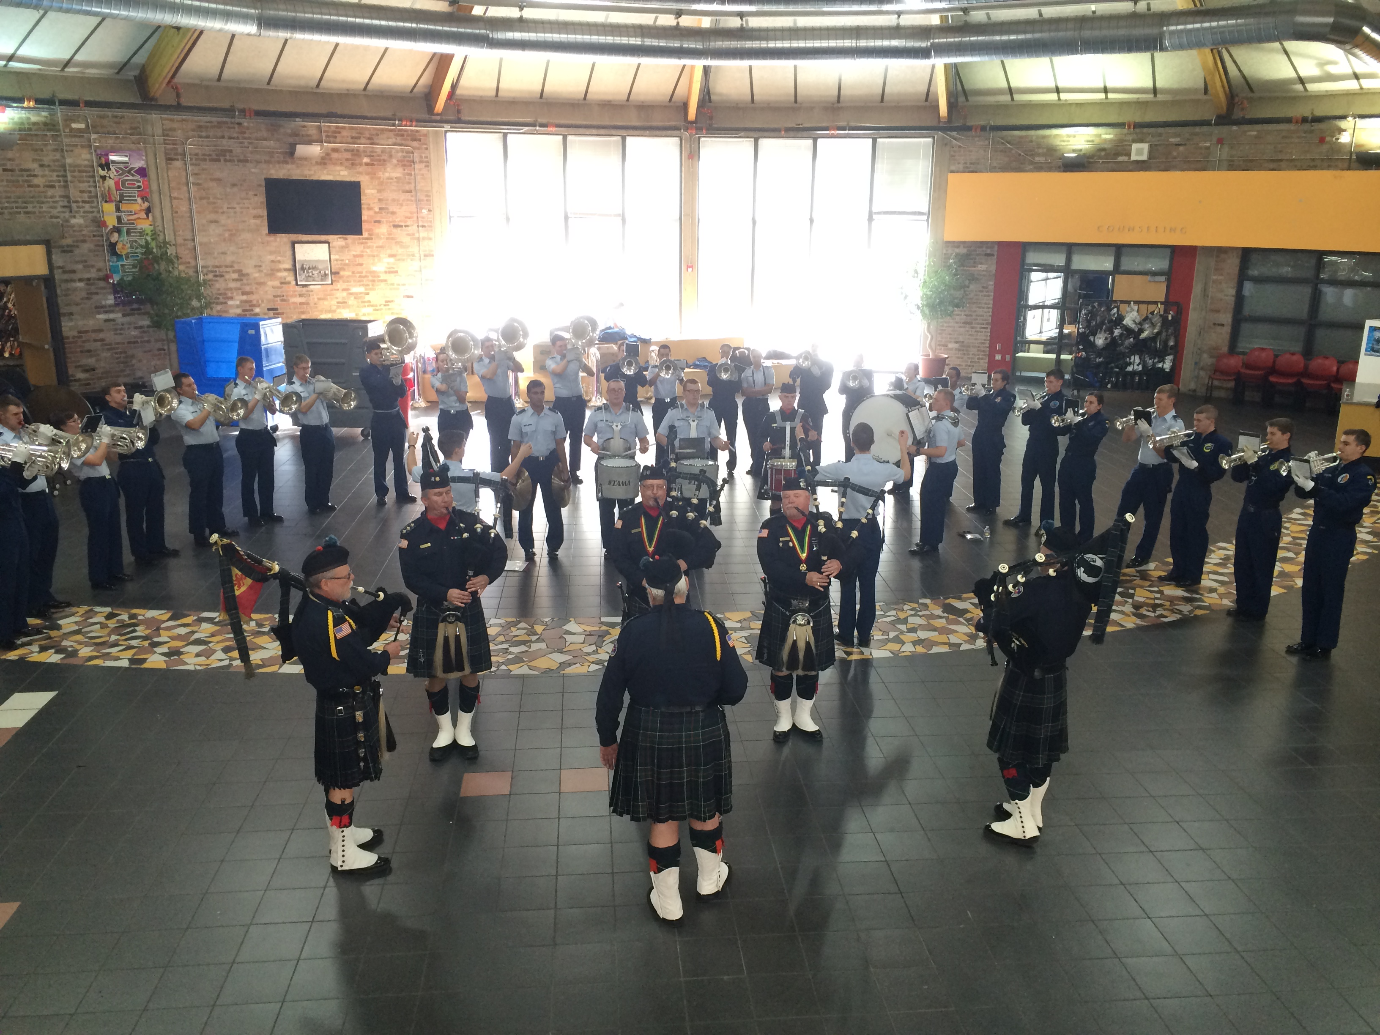
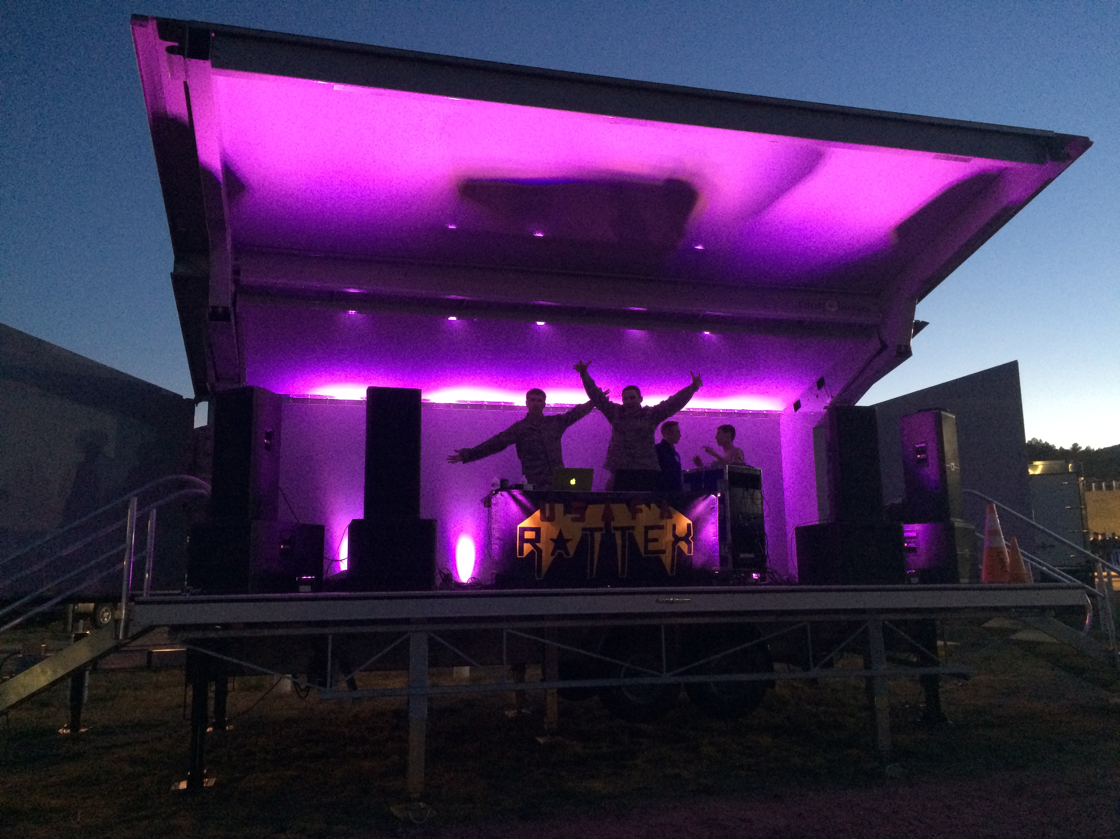
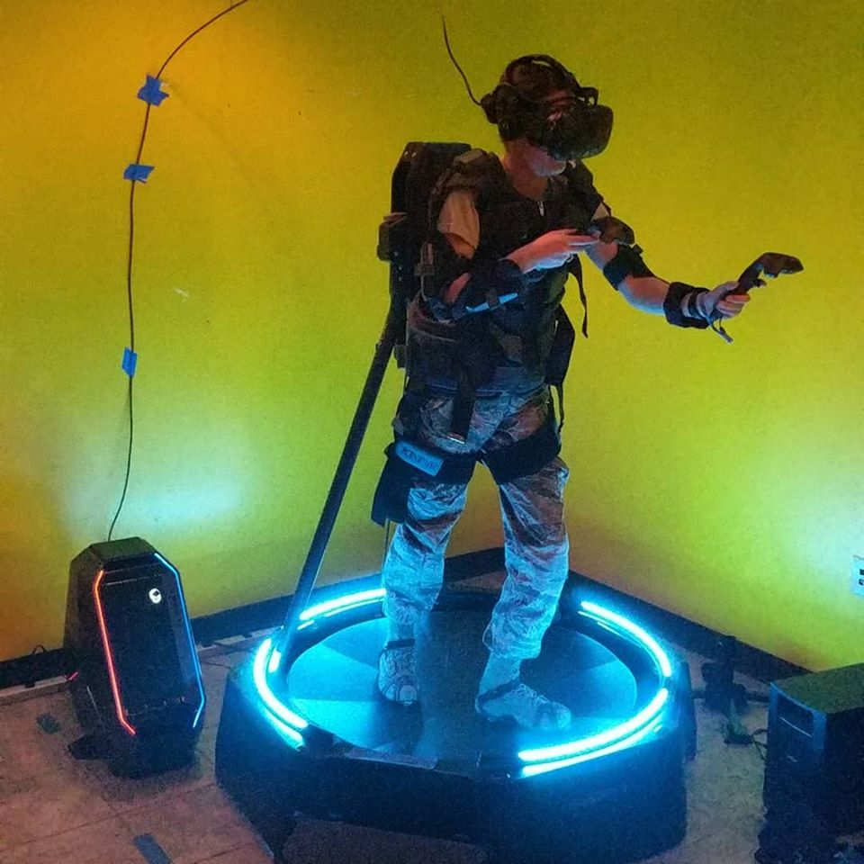

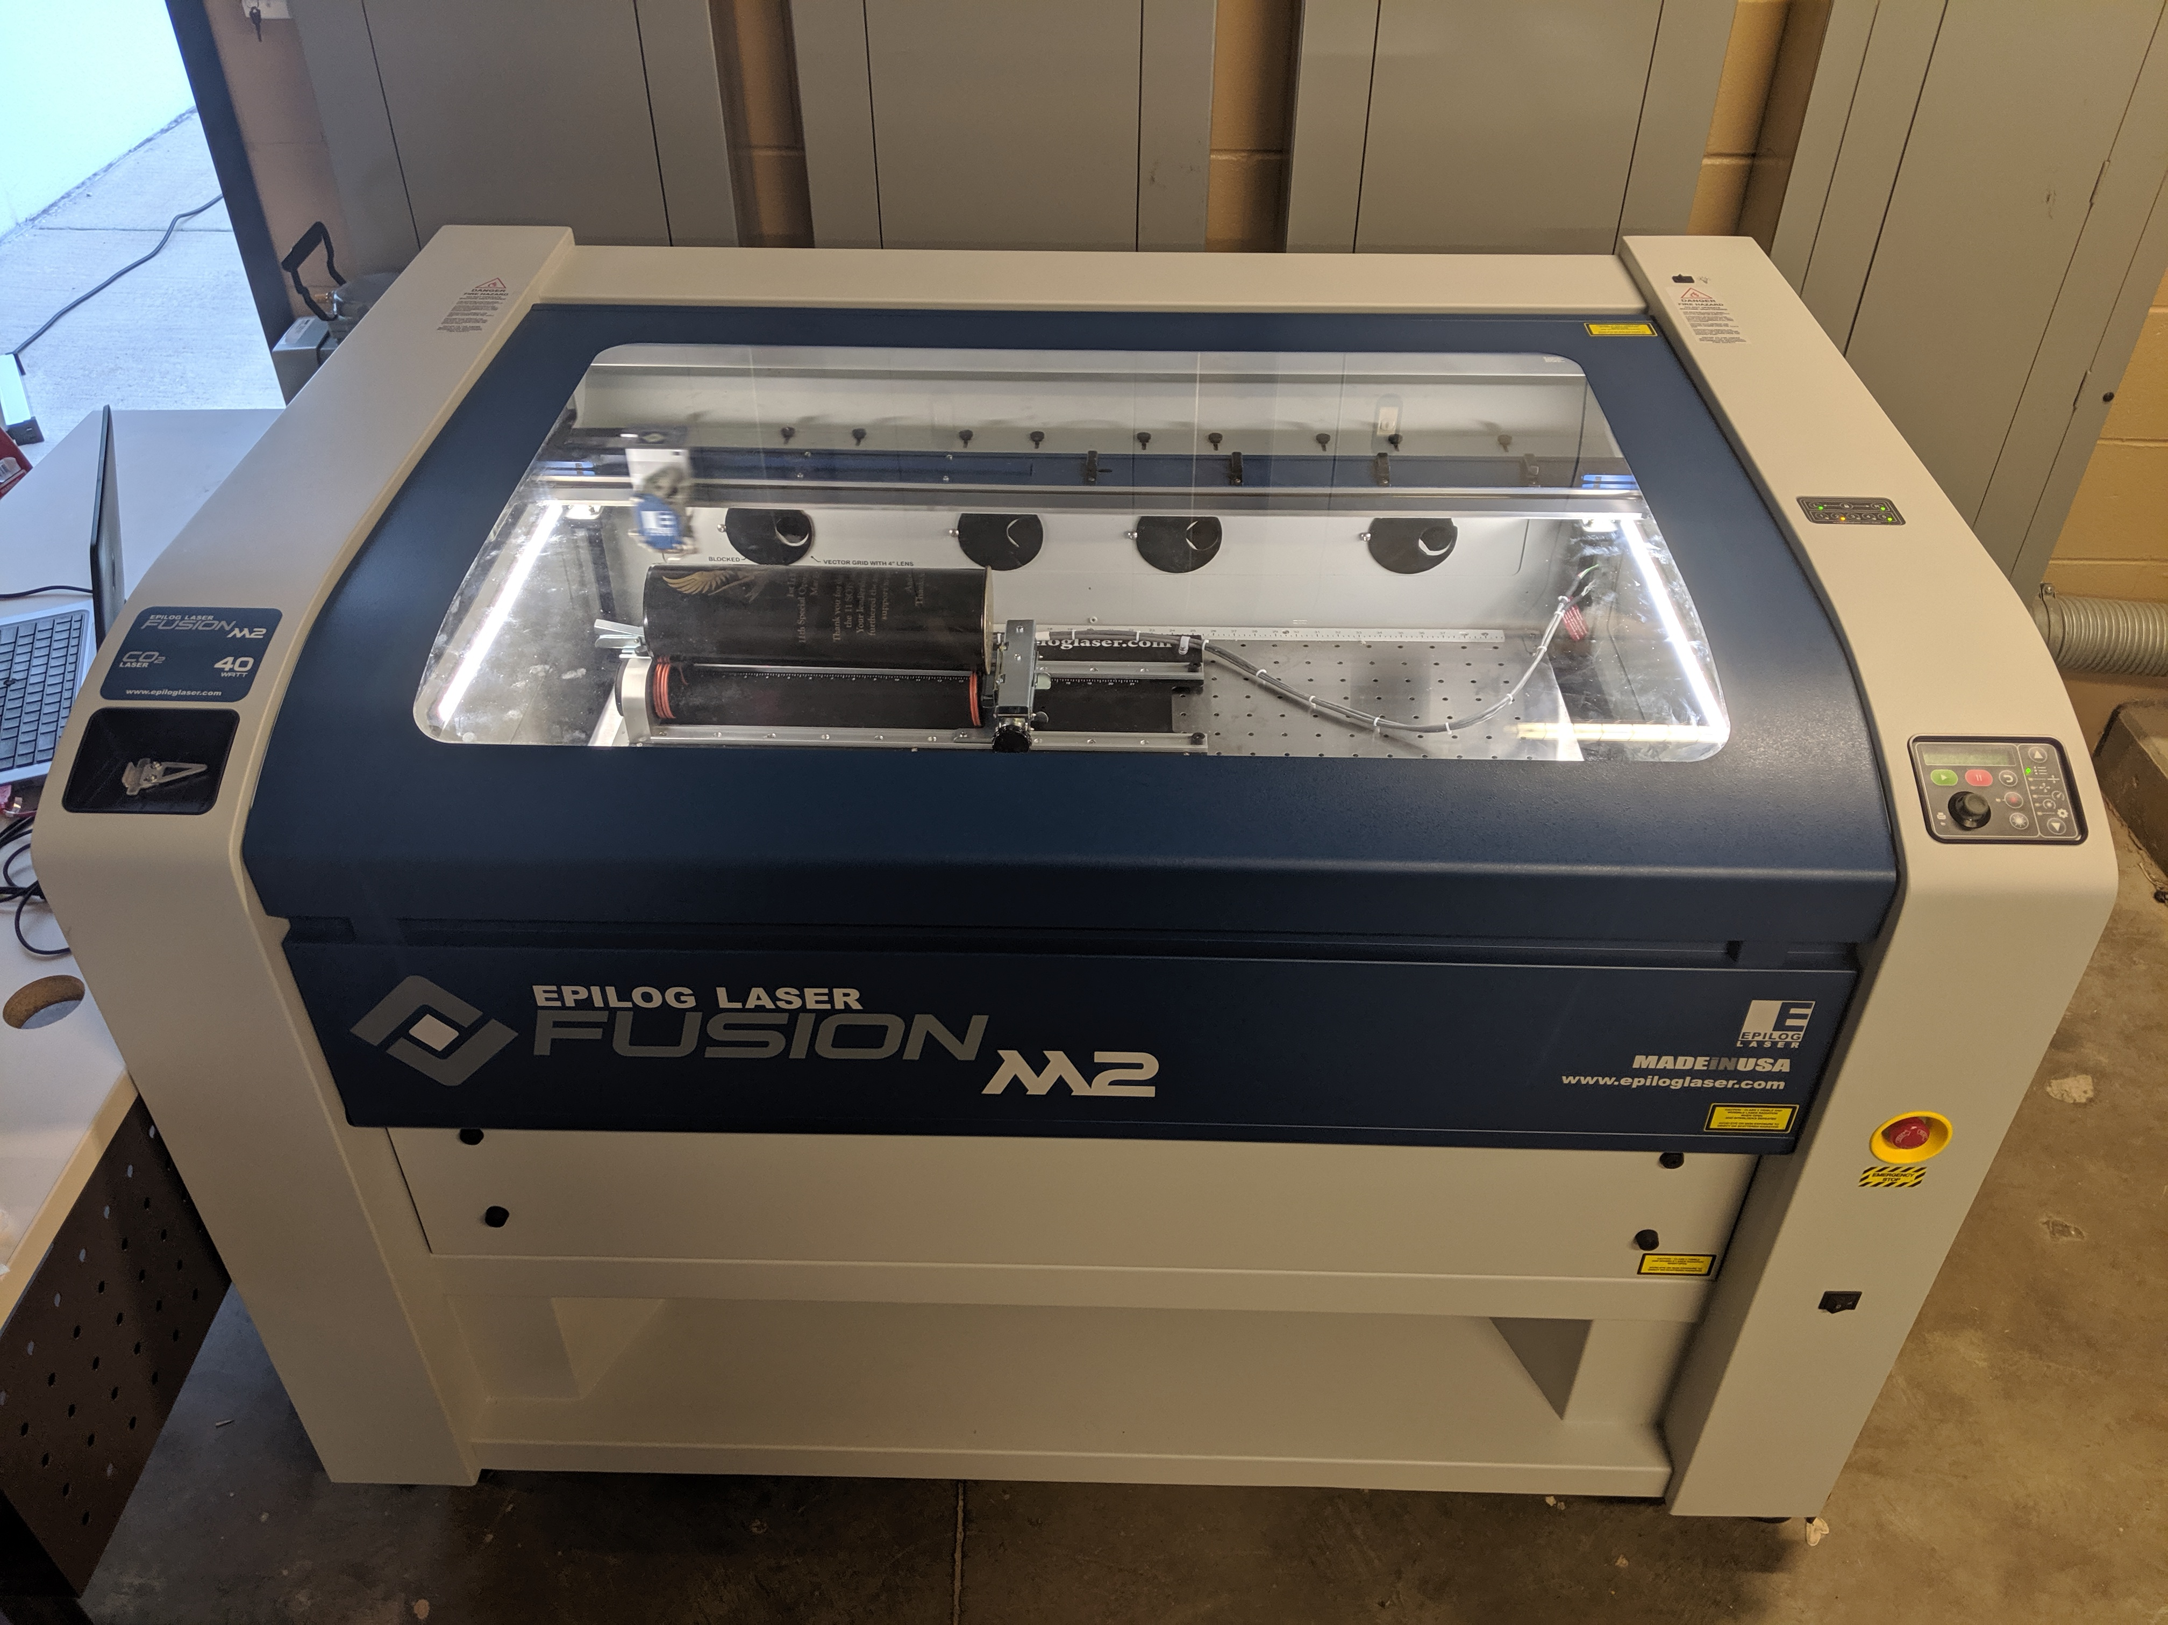
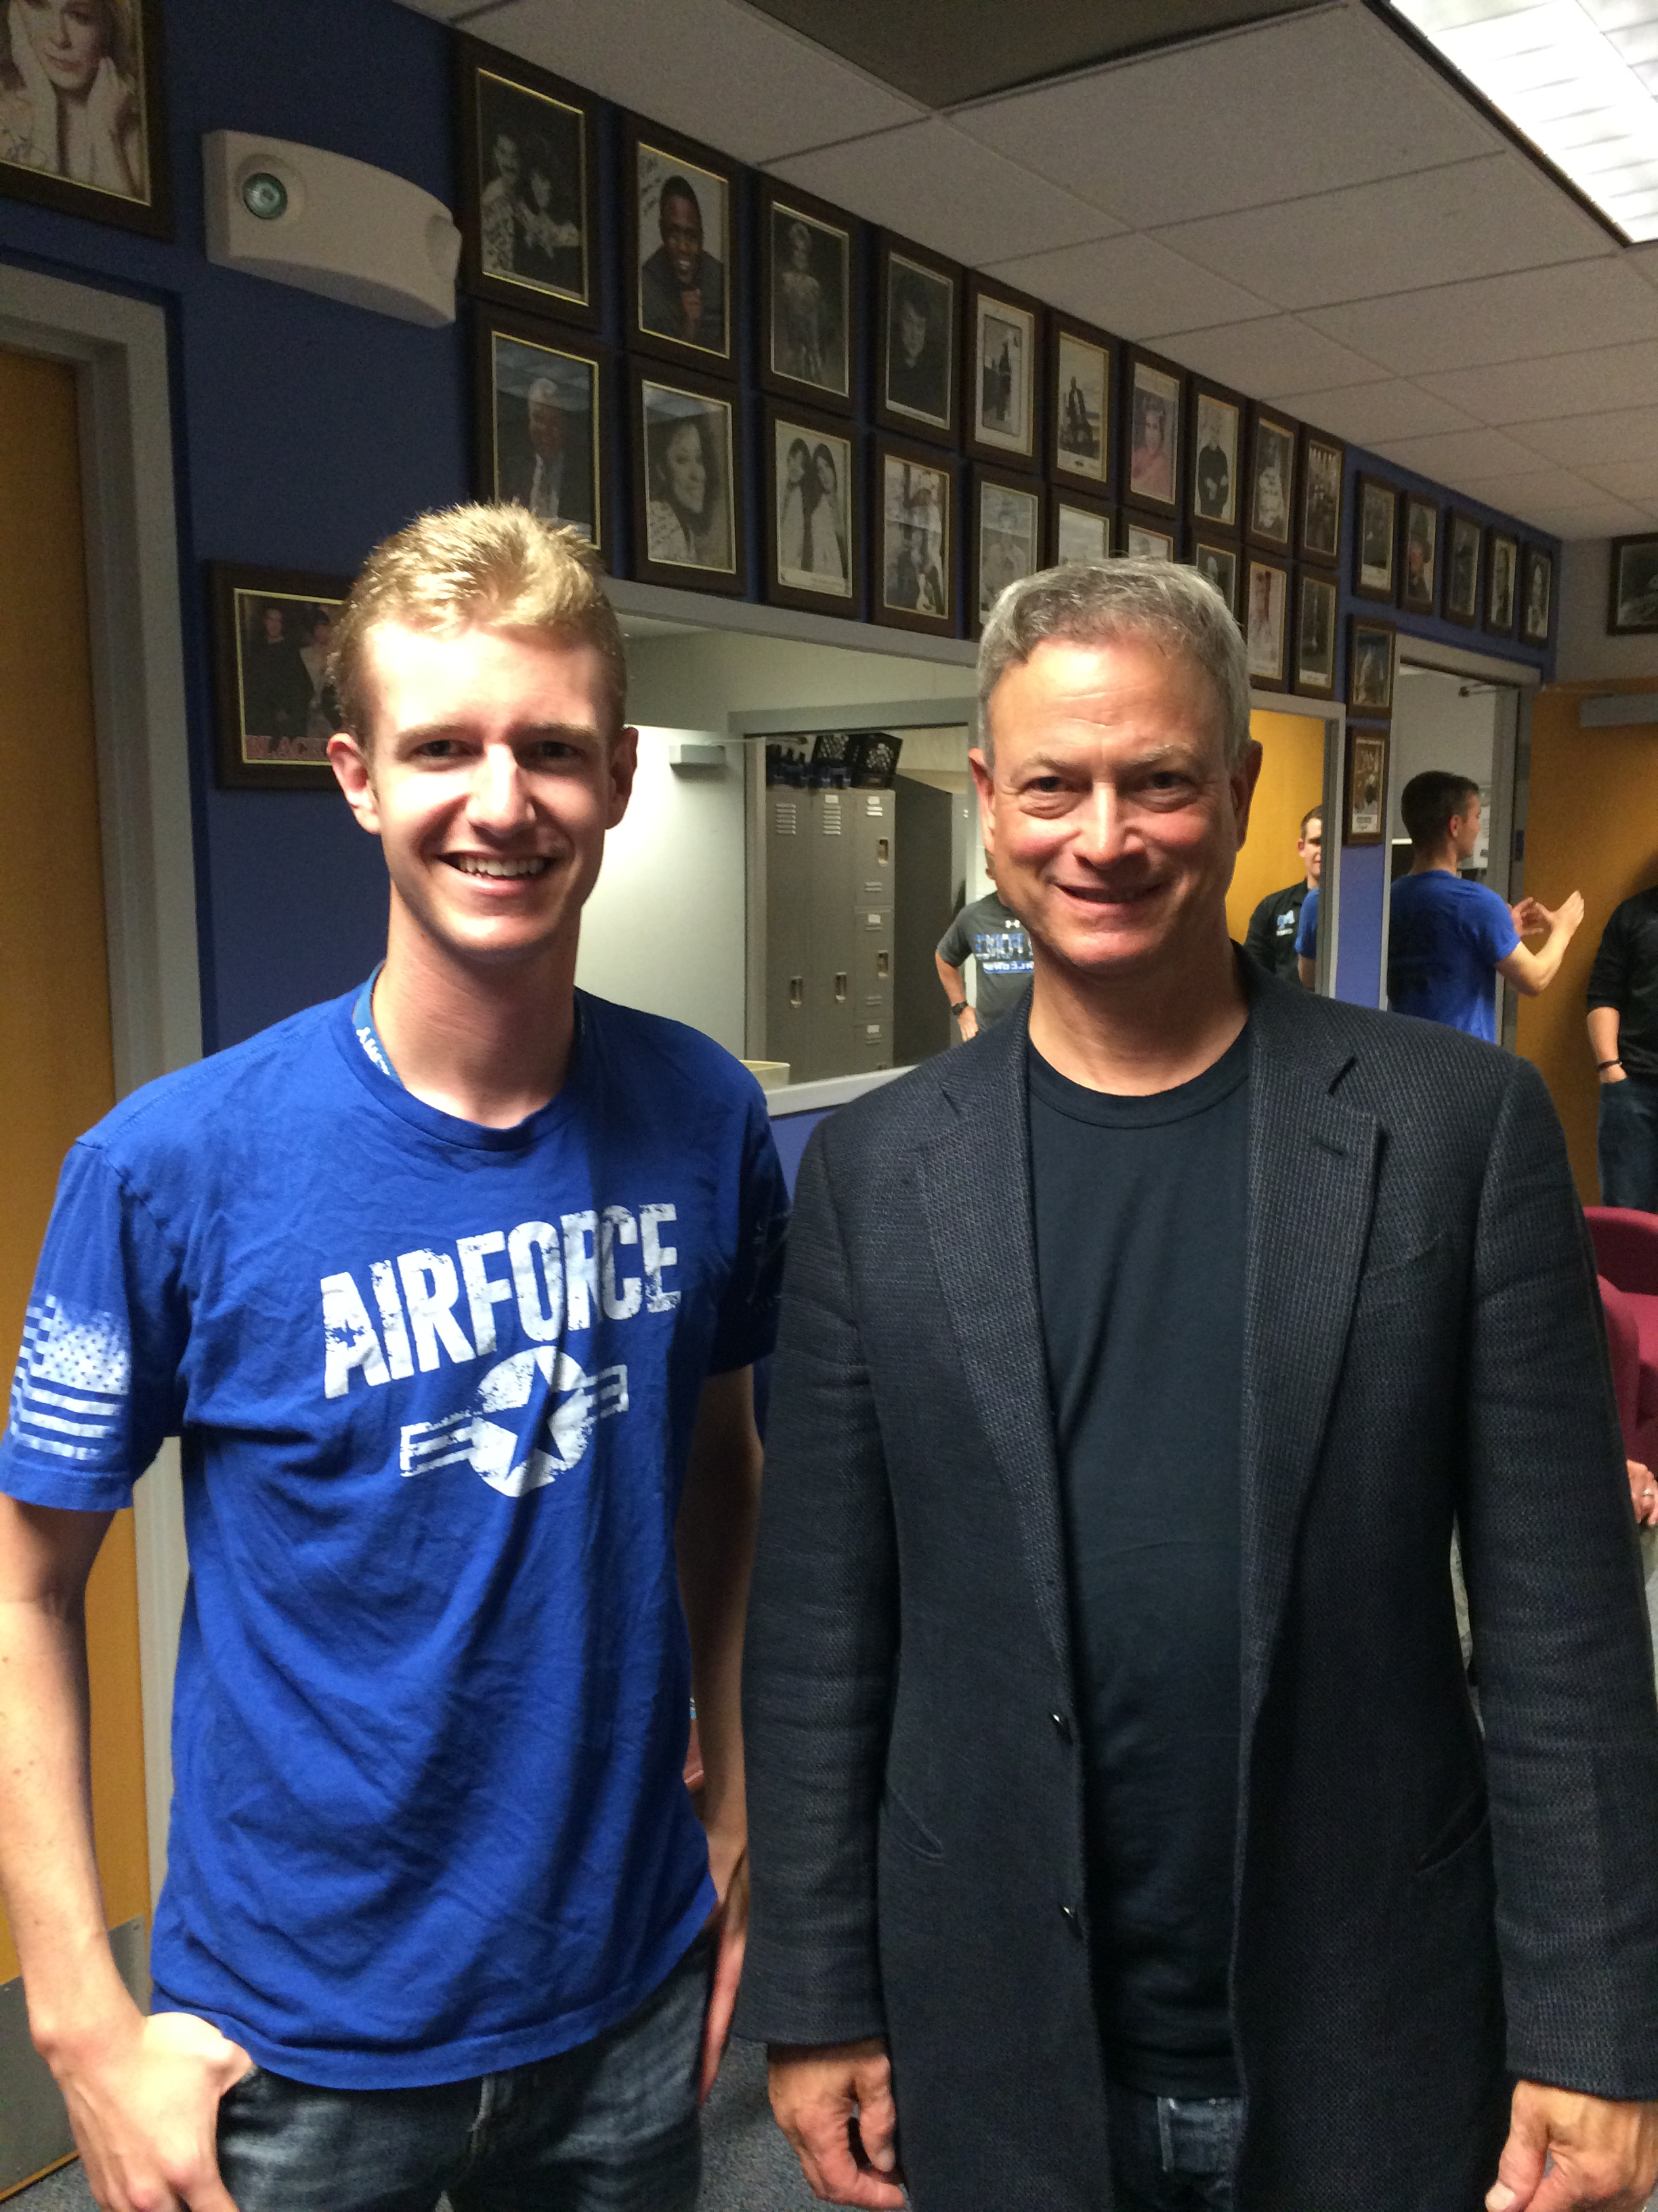


1st Lt Gareth Price
Richmond Hill High School, GA, 2013
BS in Computer Science, USAFA, 2017
17D in the USAF, Programmer at 11SOIS
SCUBA Diving
Sailing
IoT Design and Programming
3D Printing

Slide 3

Introduce Yourself!
Name
School
Grade
Hobbies
Future Job
Fun Fact

Slide 4
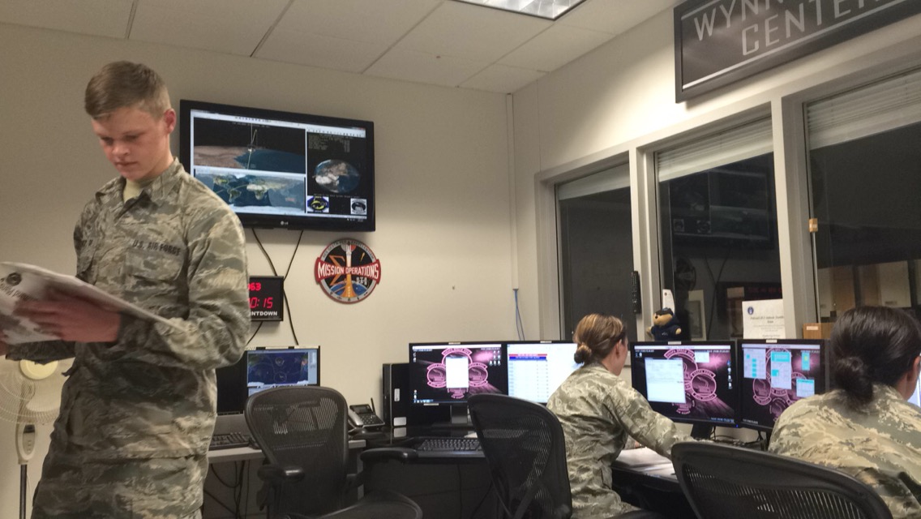
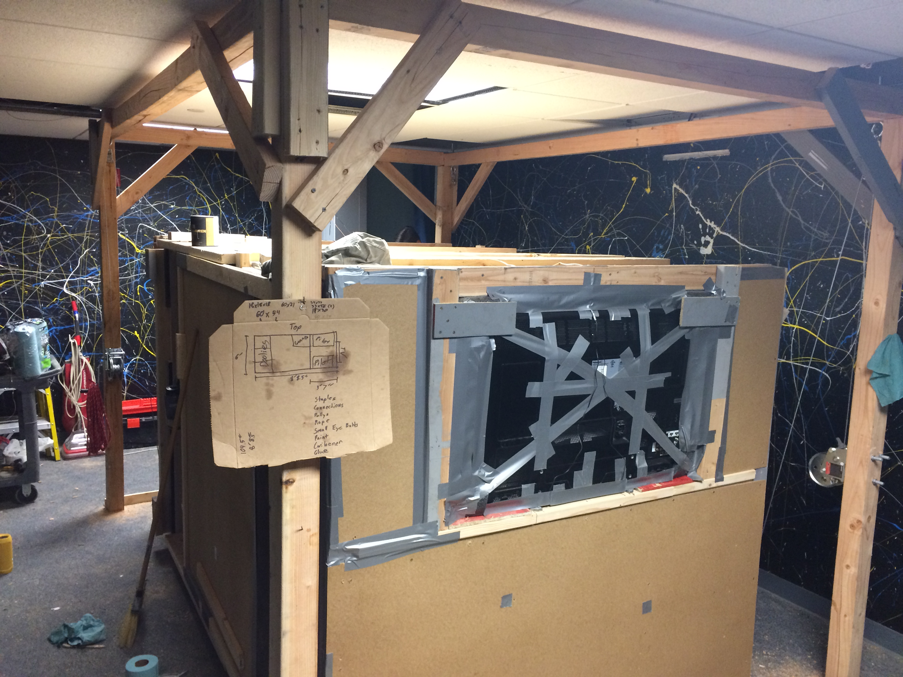
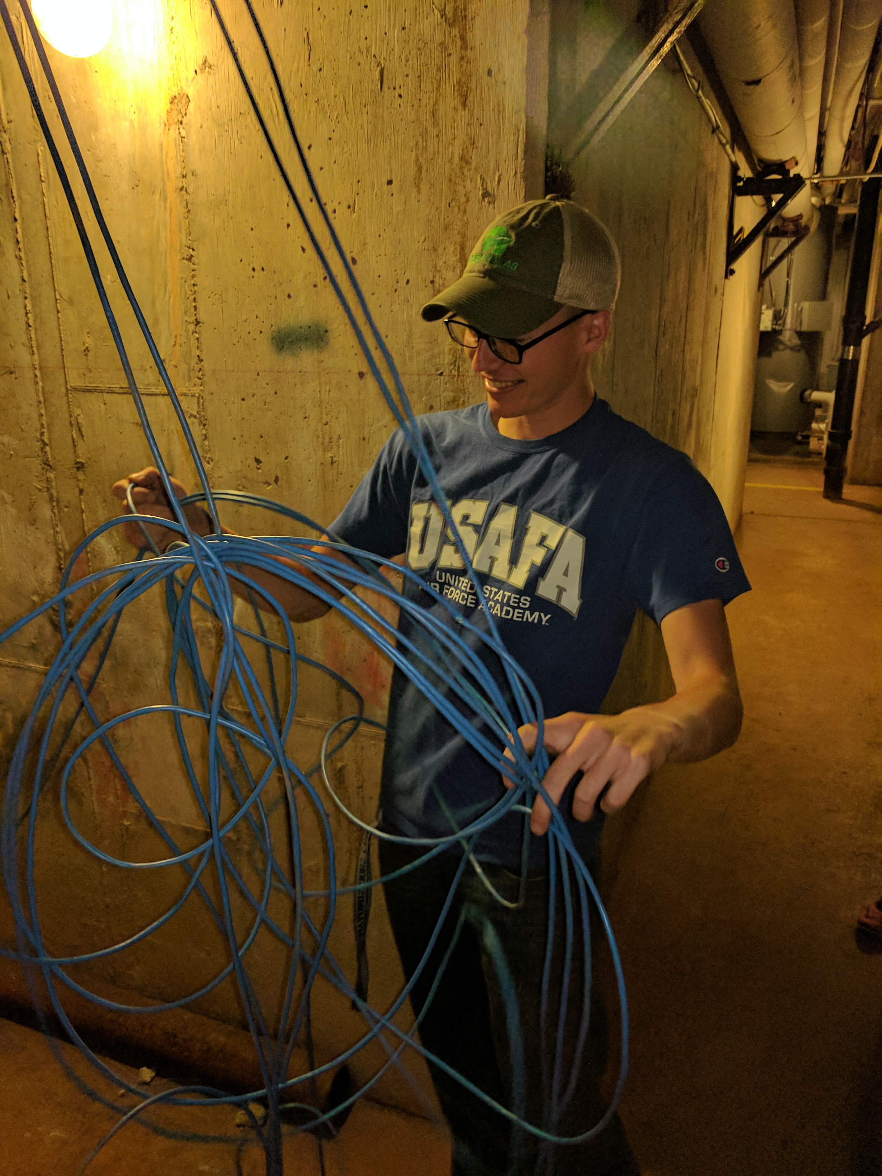
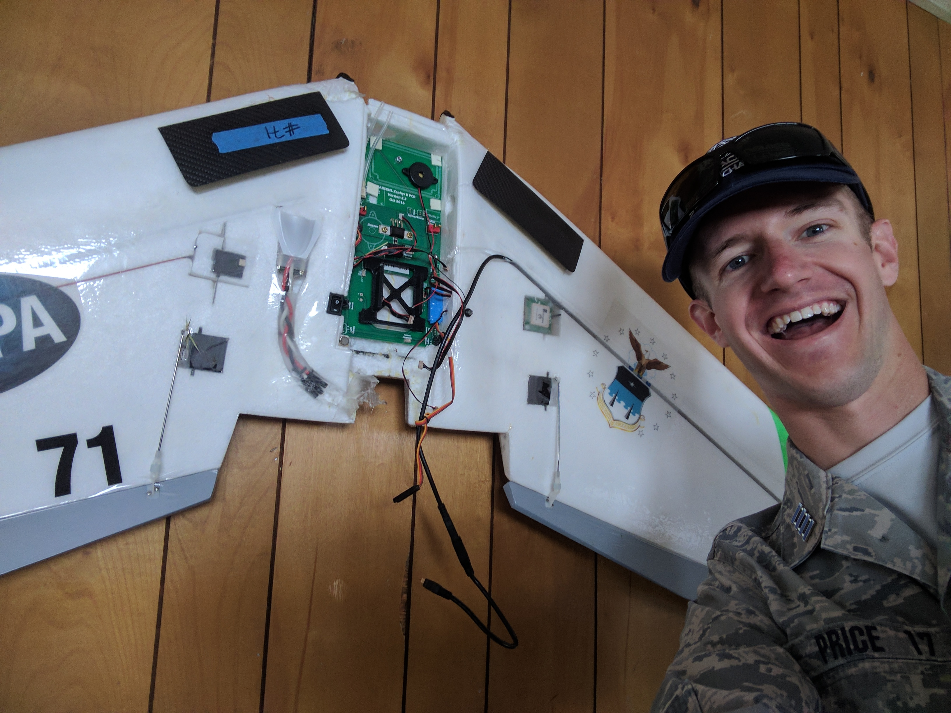
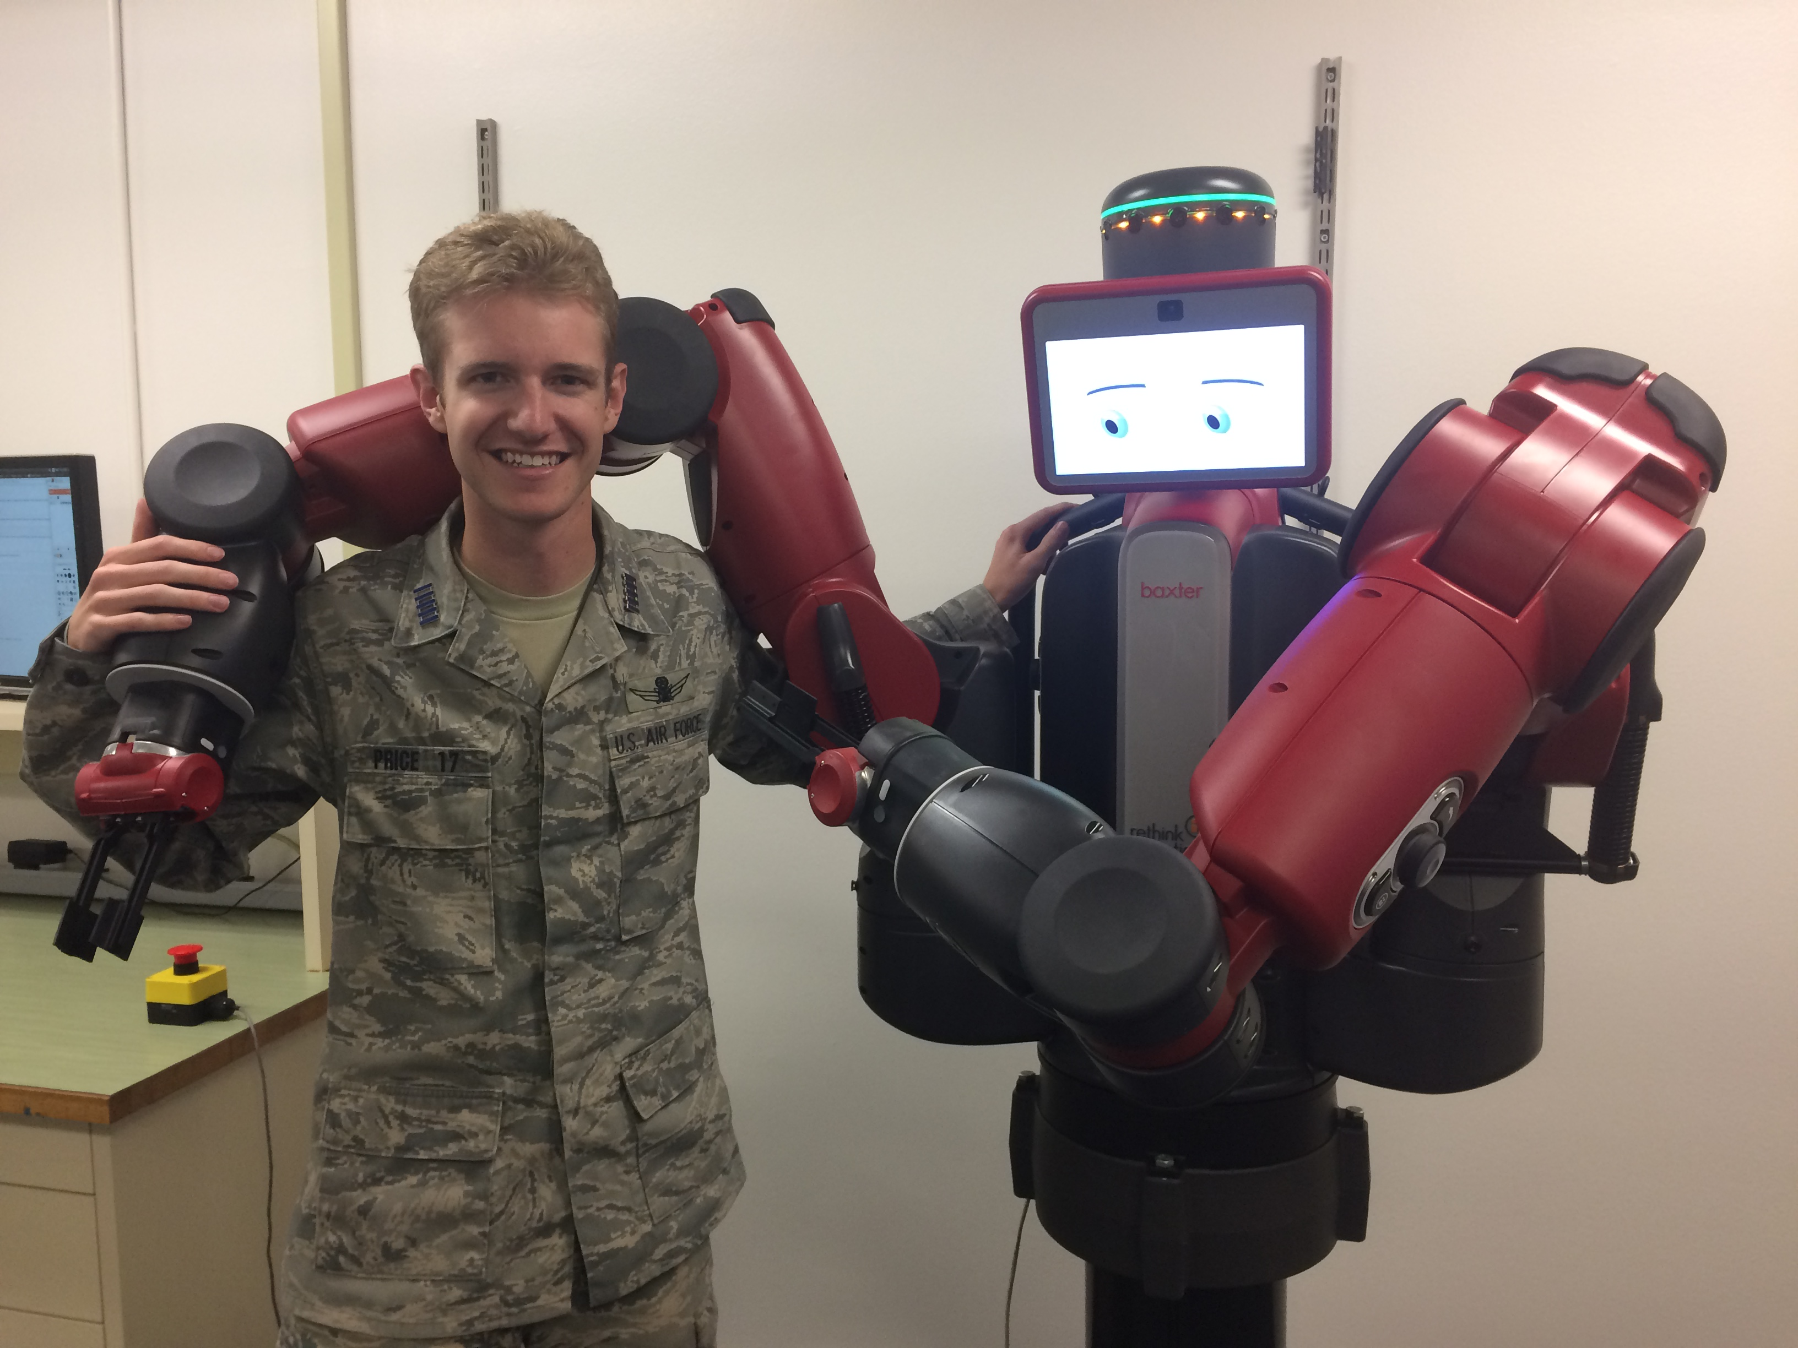

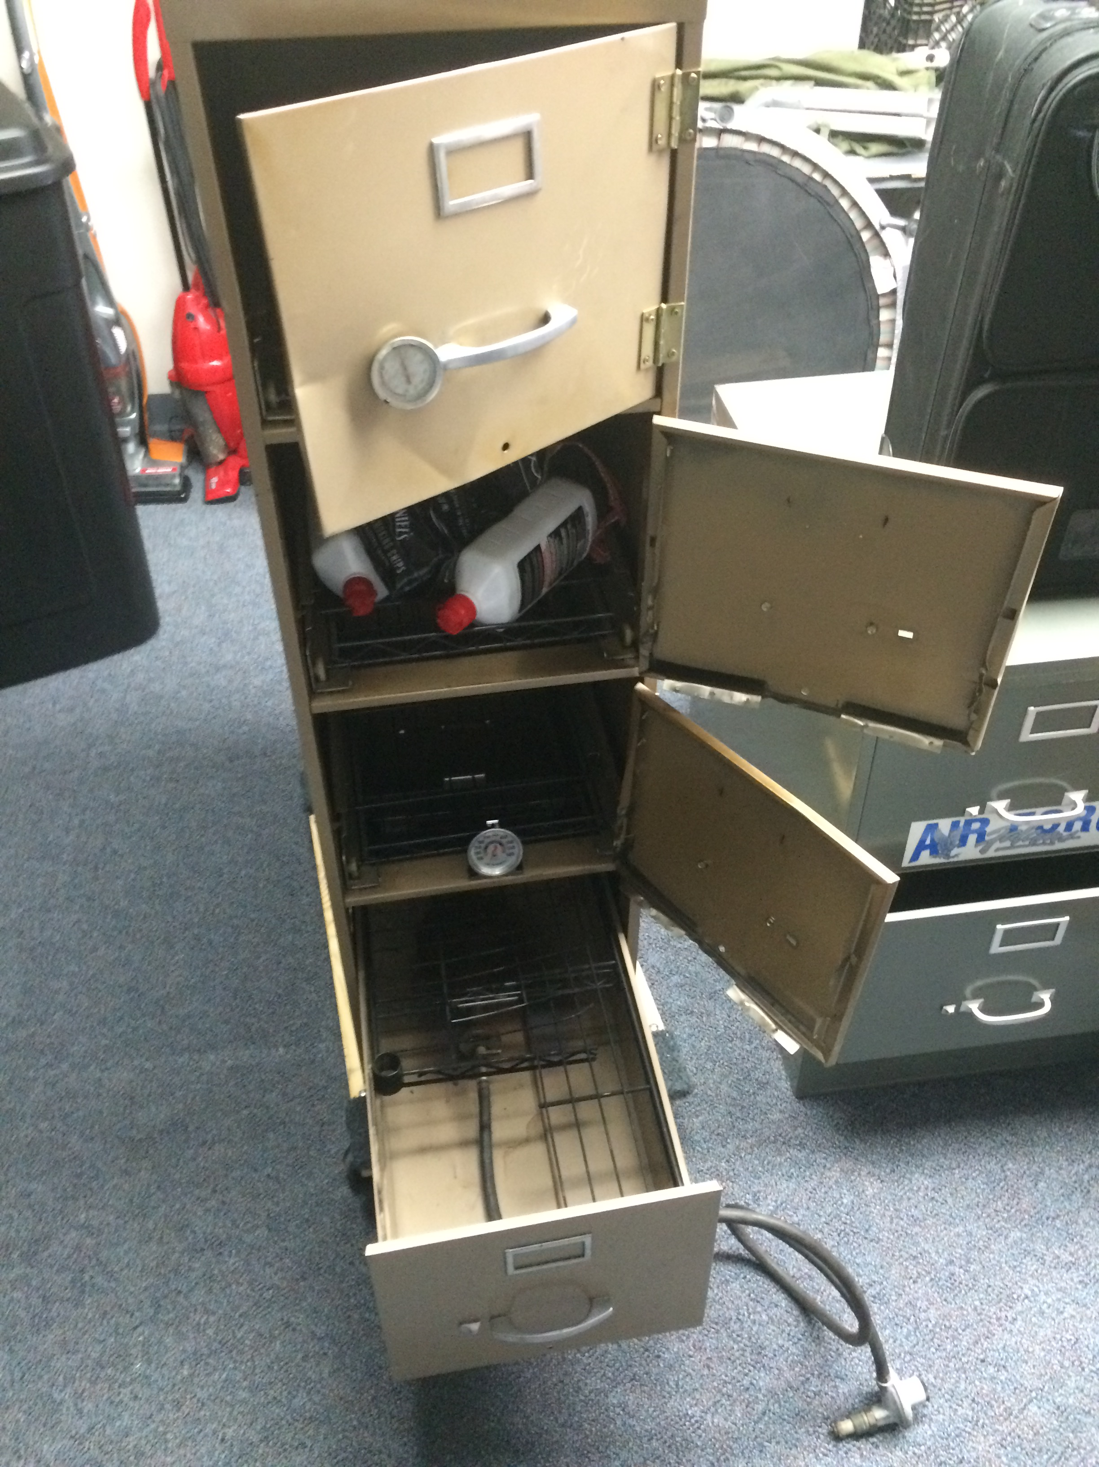
Why Learn Arduino?
It’s a gateway to engineering!

Slide 5
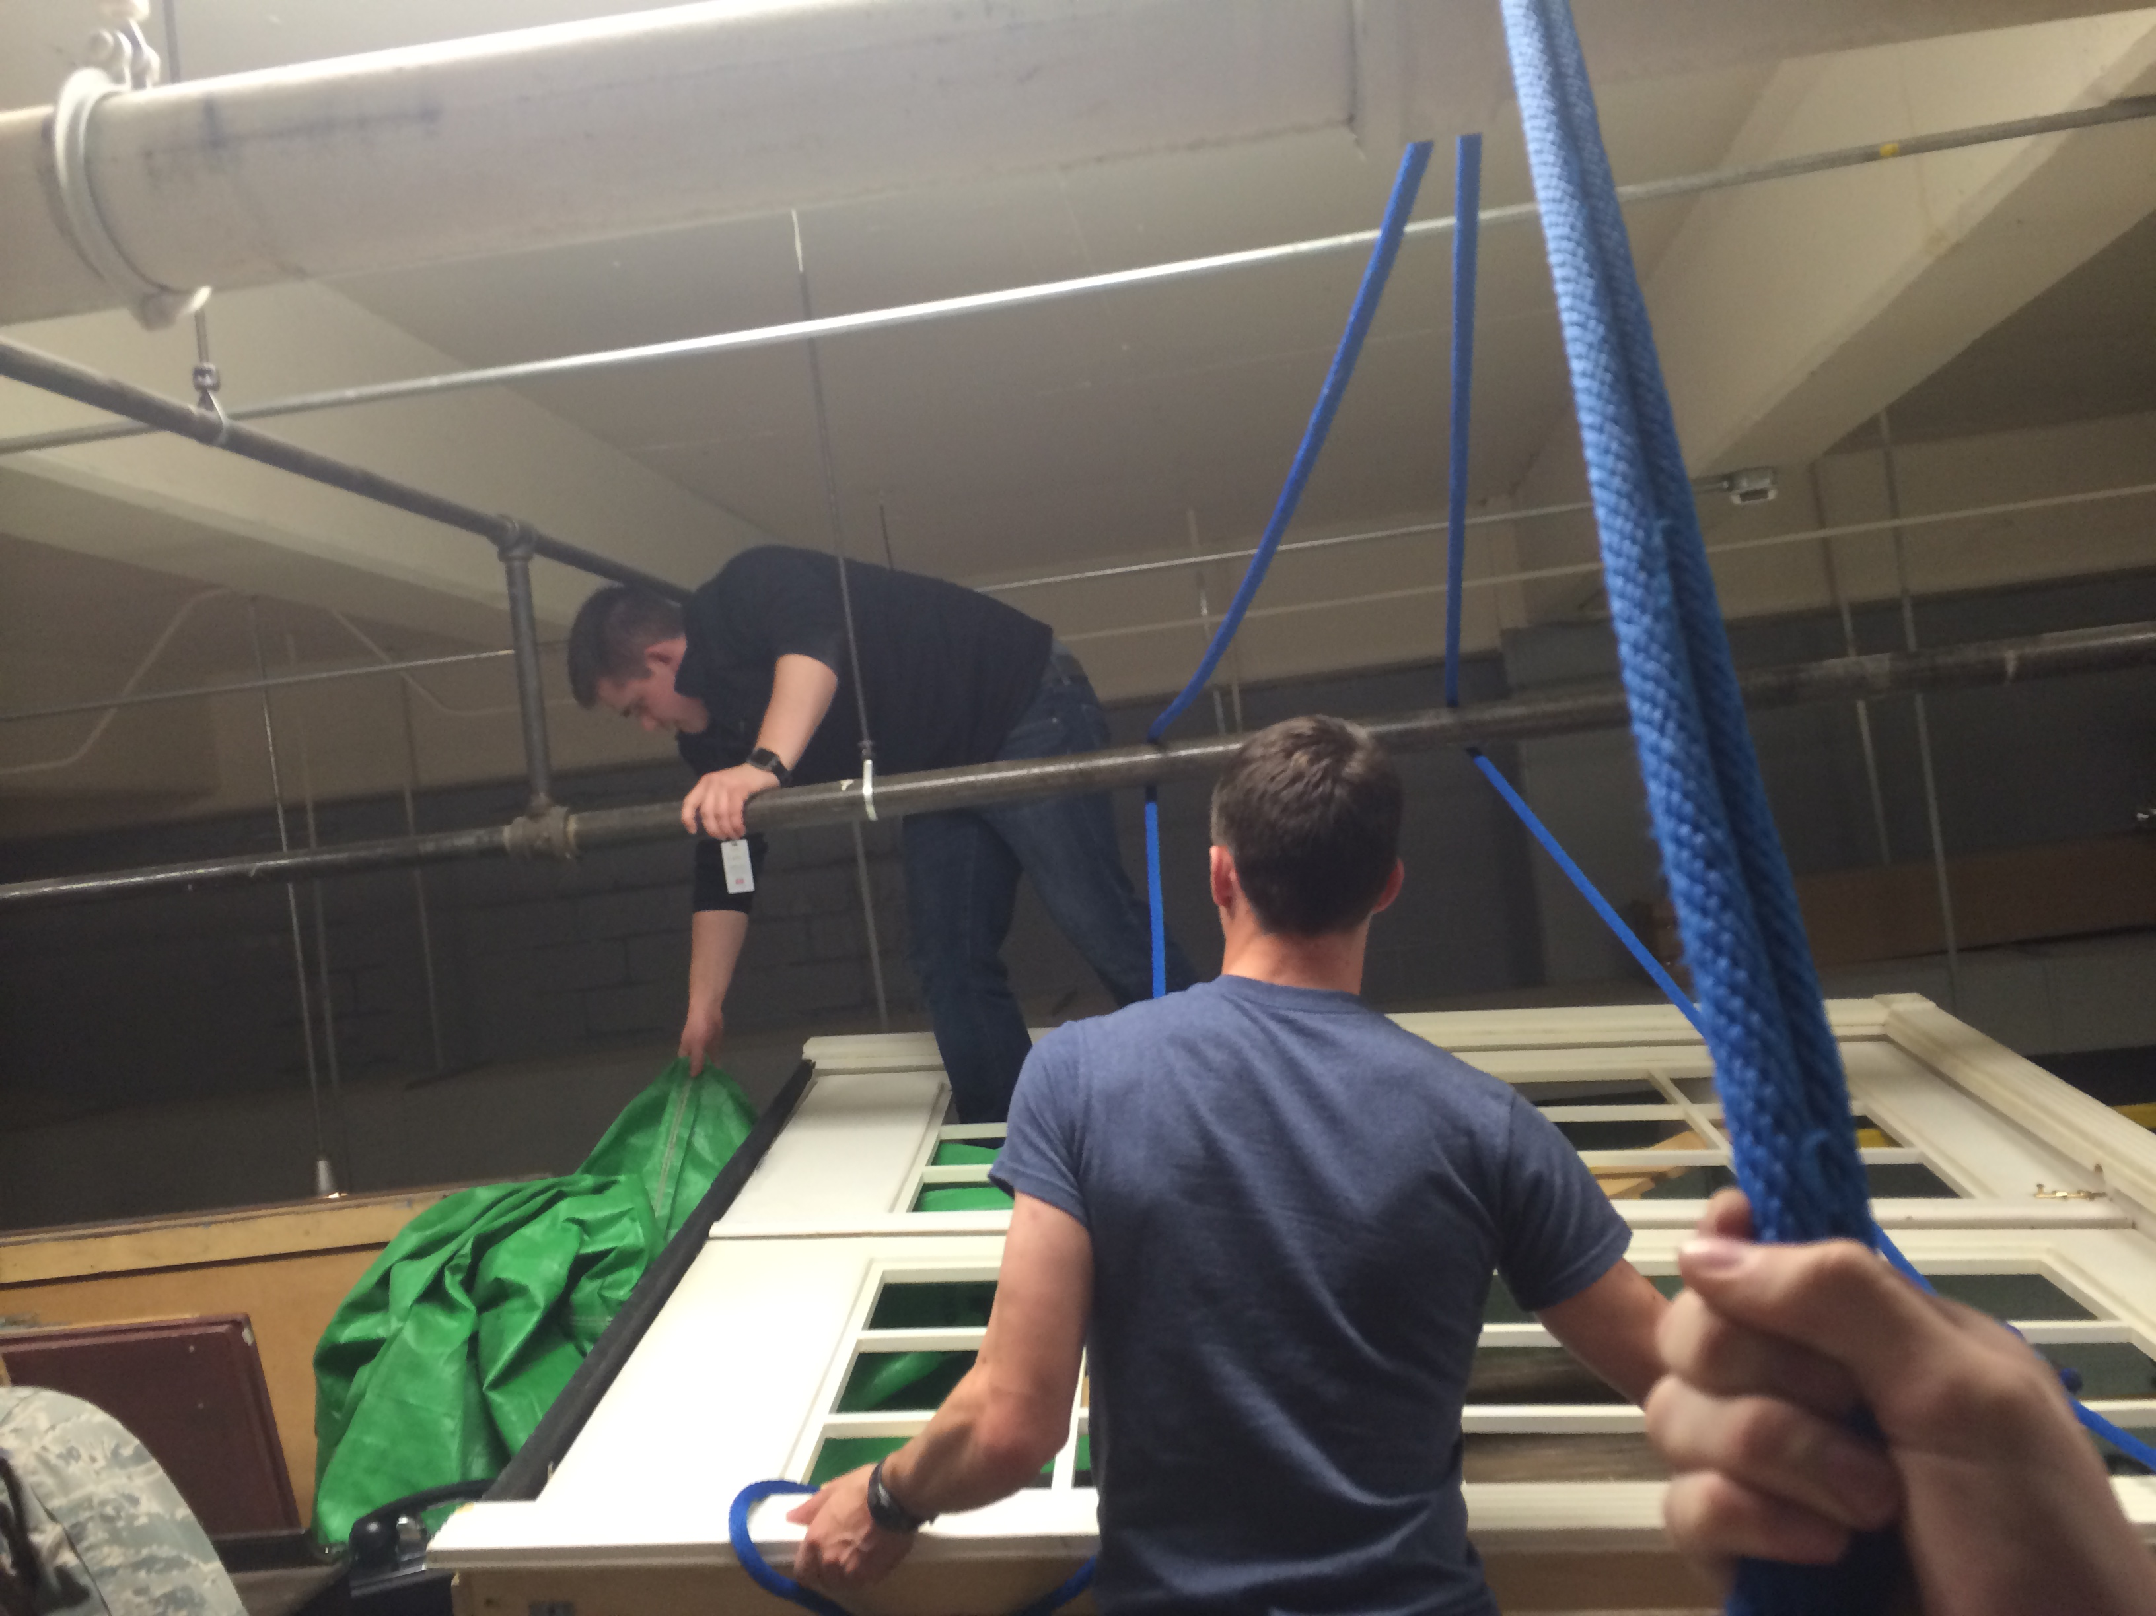
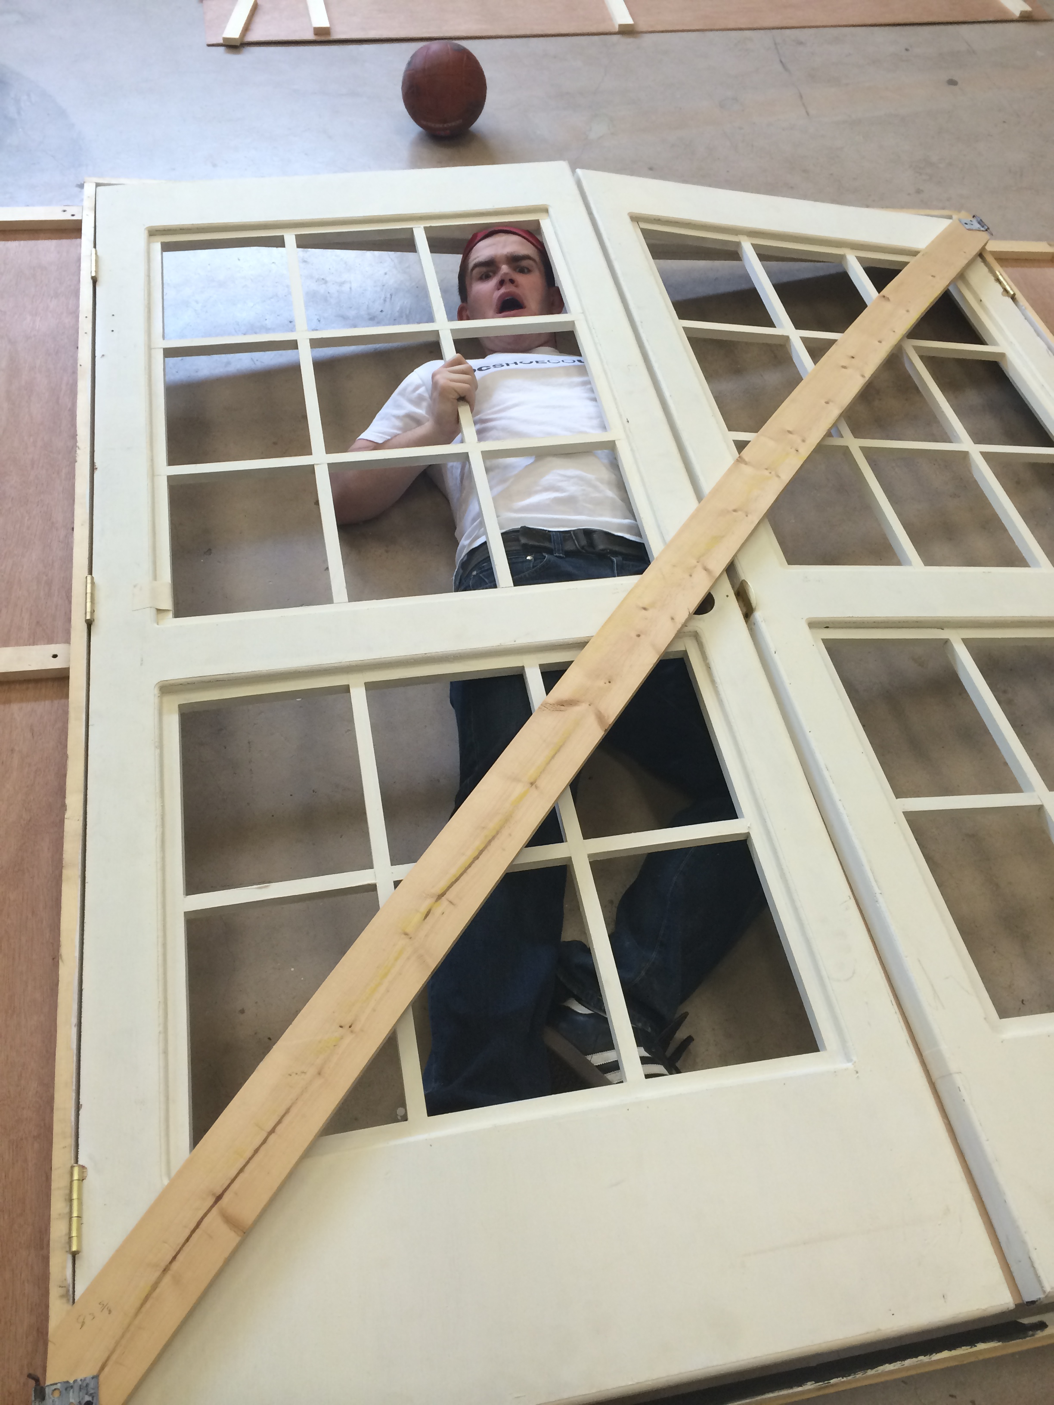
“A person who never made a mistake never tried anything new.”
-Albert Einstein

Slide 6
Safety
For Yourself
For Your Equipment
For Those Around You

Slide 7
Today’s Gameplan
The Arduino
Hardware
Software
Individual Design

Slide 8
The Arduino
Computer Science is no more about computers than astronomy is about telescopes.
-Edsger Dijkstra

Slide 9
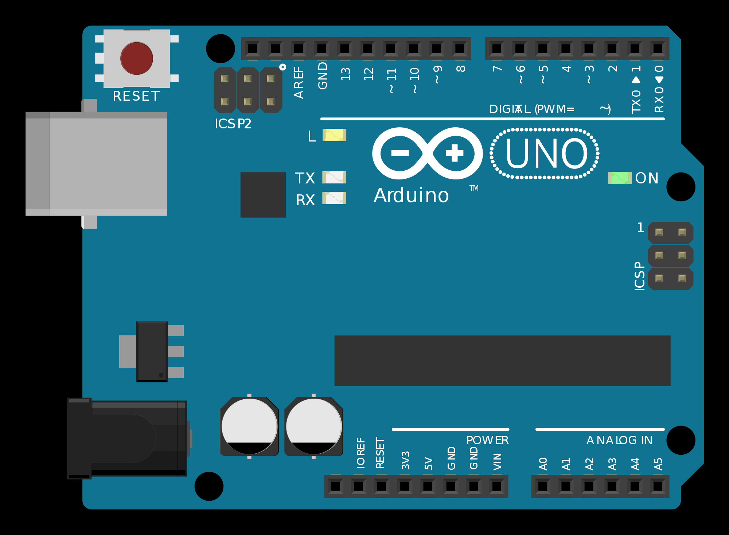
Notes:
Reset Button
USB Jack
Barrel Jack
Power Pins
Analog Pins
Digital Pins

Slide 10
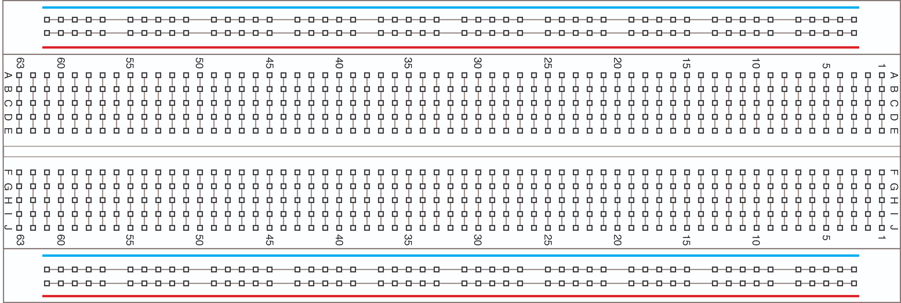
Notes:
Internal Connections

Slide 11
Hardware
Its hardware that makes a machine fast. Its software that makes a fast machine slow.
-Craig Bruce

Slide 12


Voltage
The “Force” in a circuit
Similar to Water Pressure
Total Voltage in a loop equals 0
Too Much Voltage Can Cause Damage

Slide 13
Current
The Rate of Flow of Electricity
Similar to Water Flow
Total Current Limited by Source

Slide 14
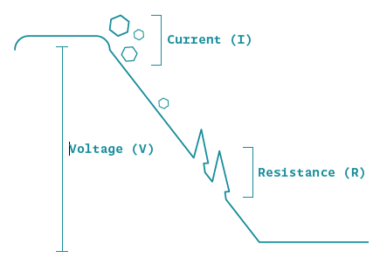
Resistance
The “Consumer” in a circuit
Similar to a Blockage in the Pipe
Devices the do Work
Remember Energy is Conserved

Slide 15
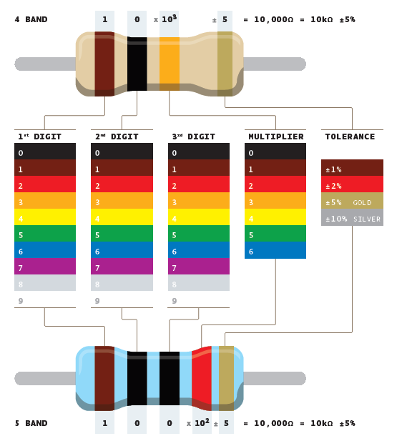
Resistor
Creates a Voltage Drop
Converts Electricity to Heat

Slide 16
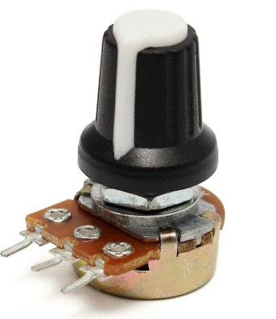
Potentiometer
Variable Resistor
Center Pin Measures Resistance

Slide 17
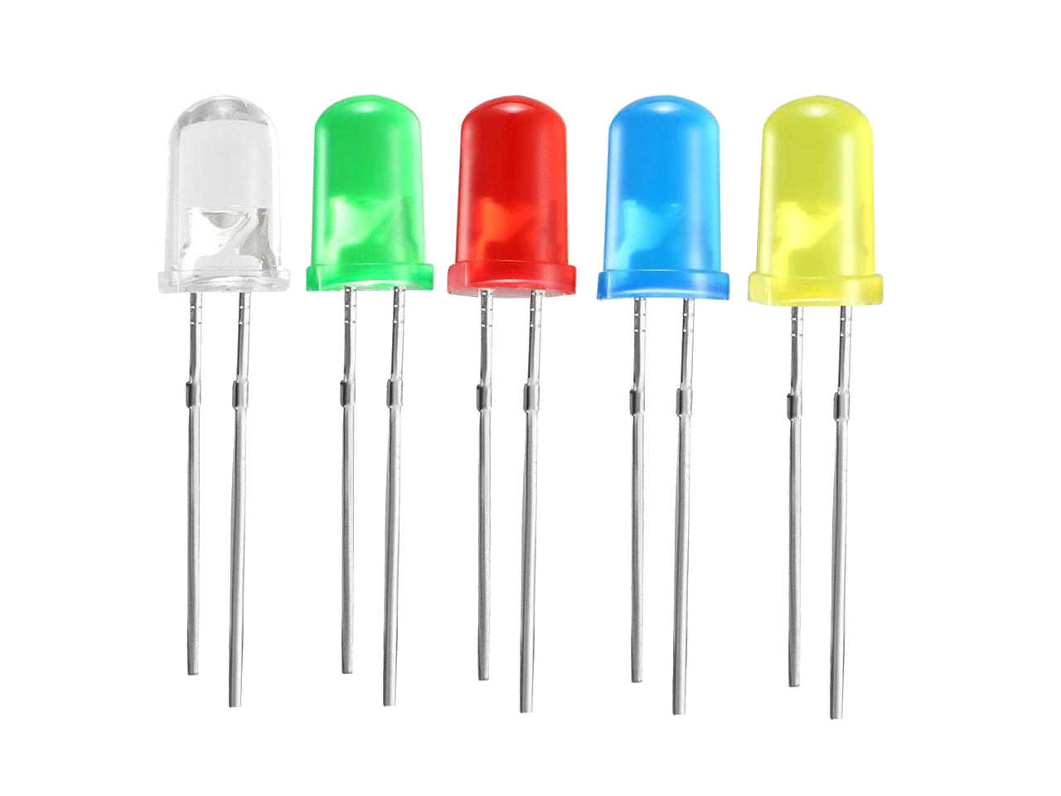
LED
Light Emitting Diode
3.2V to Turn On
Uses 300mA
One-Way Device

Slide 18
Time to Build!

Slide 19
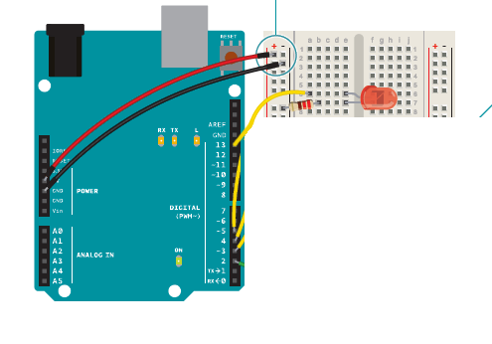
Blink

Slide 20
Software
Computers themselves, and software yet to be developed, will revolutionize the way we learn.
-Steve Jobs

Slide 21
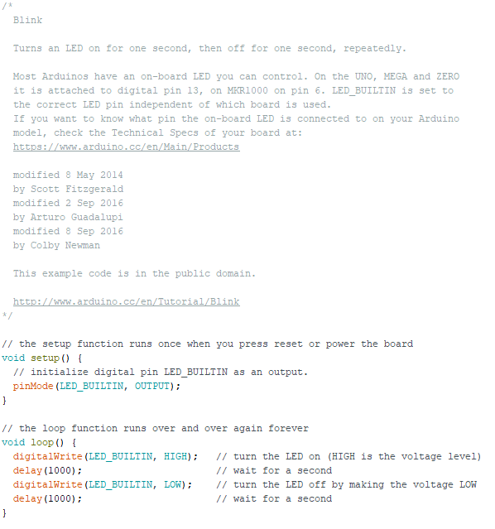
Blink

Slide 22
Creative
Creativity is intelligence having fun.
-Albert Einstein

Slide 23
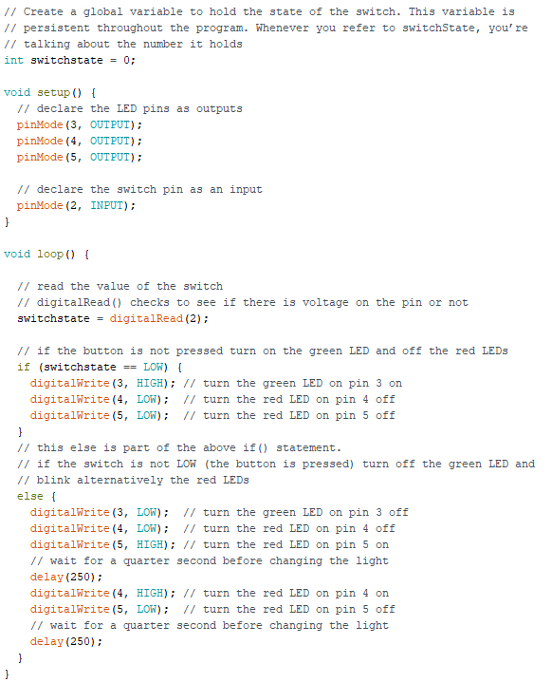
Spaceship

Slide 24
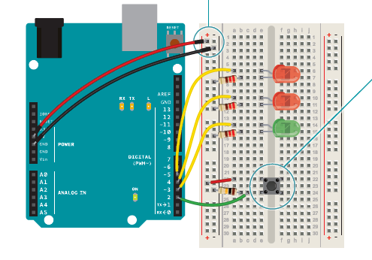
Spaceship

Slide 25
Content in three columns
Content A
Content B
Content C
Content itself is what the end-user derives value from also can refer to the information provided through the medium,
Content itself is what the end-user derives value from also can refer to the information provided through the medium,
Content itself is what the end-user derives value from also can refer to the information provided through the medium,

Slide 26
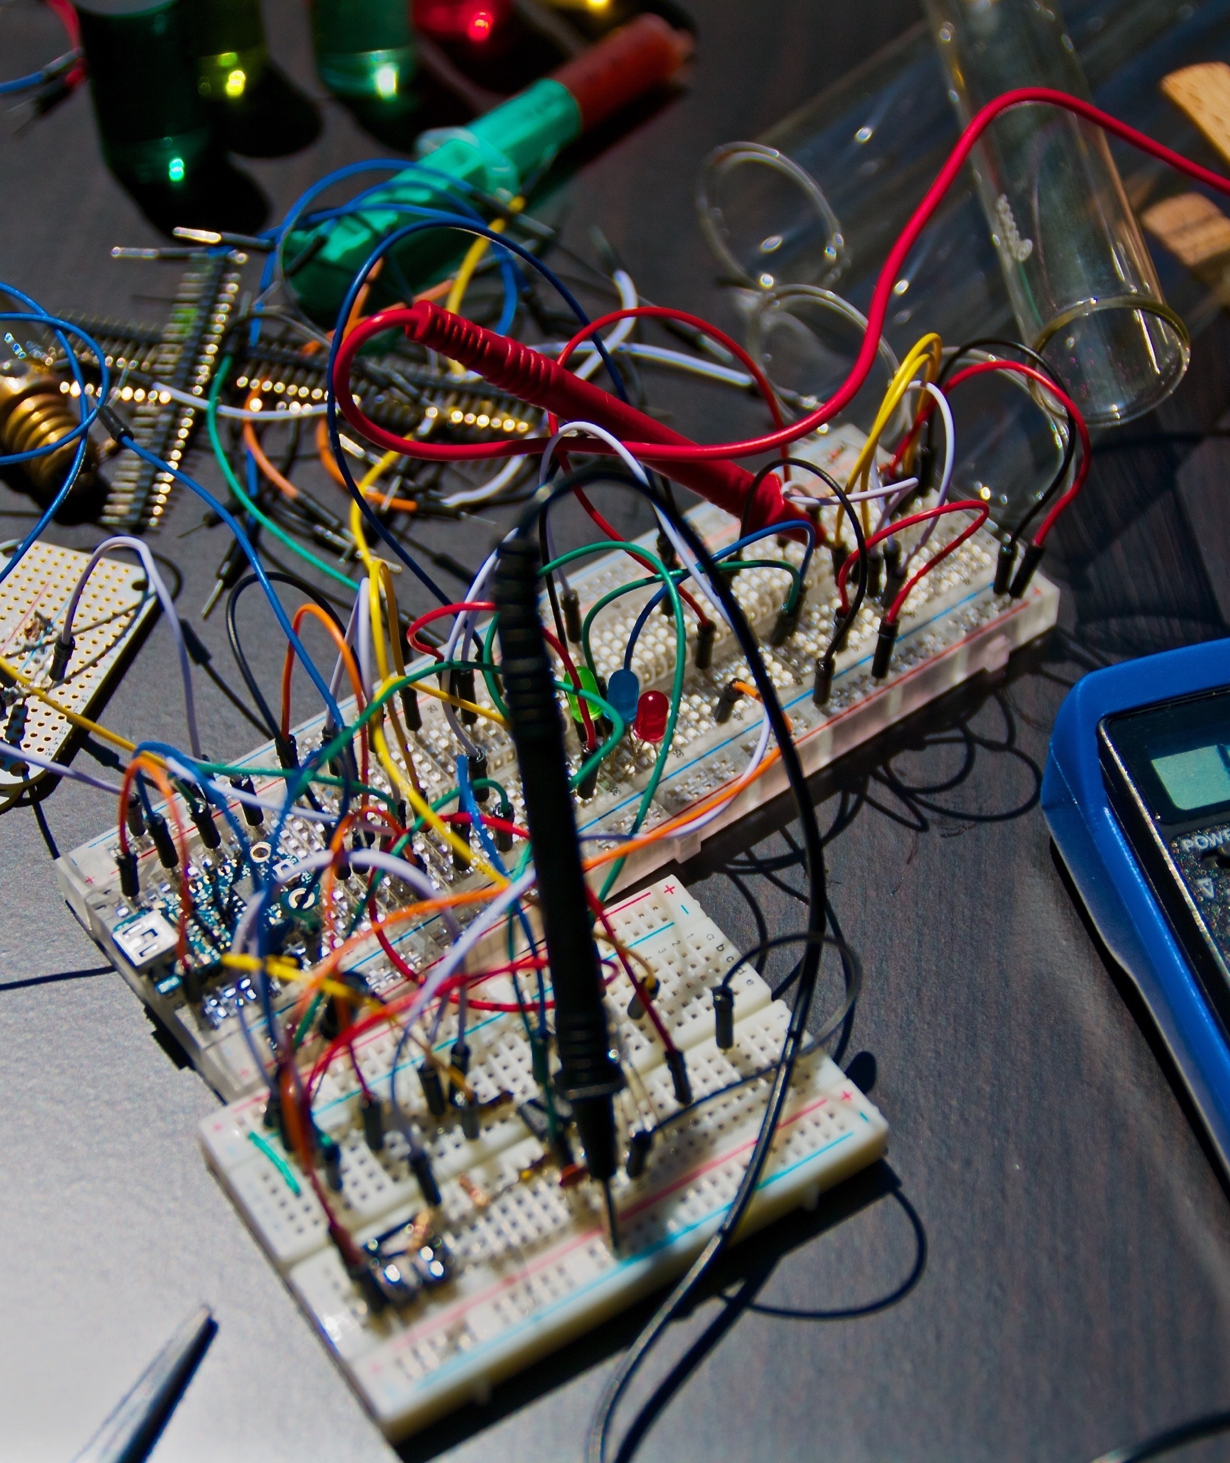
A Picture Is Worth A Thousand Words
Itself is what the end-user derives value from also.

Slide 27
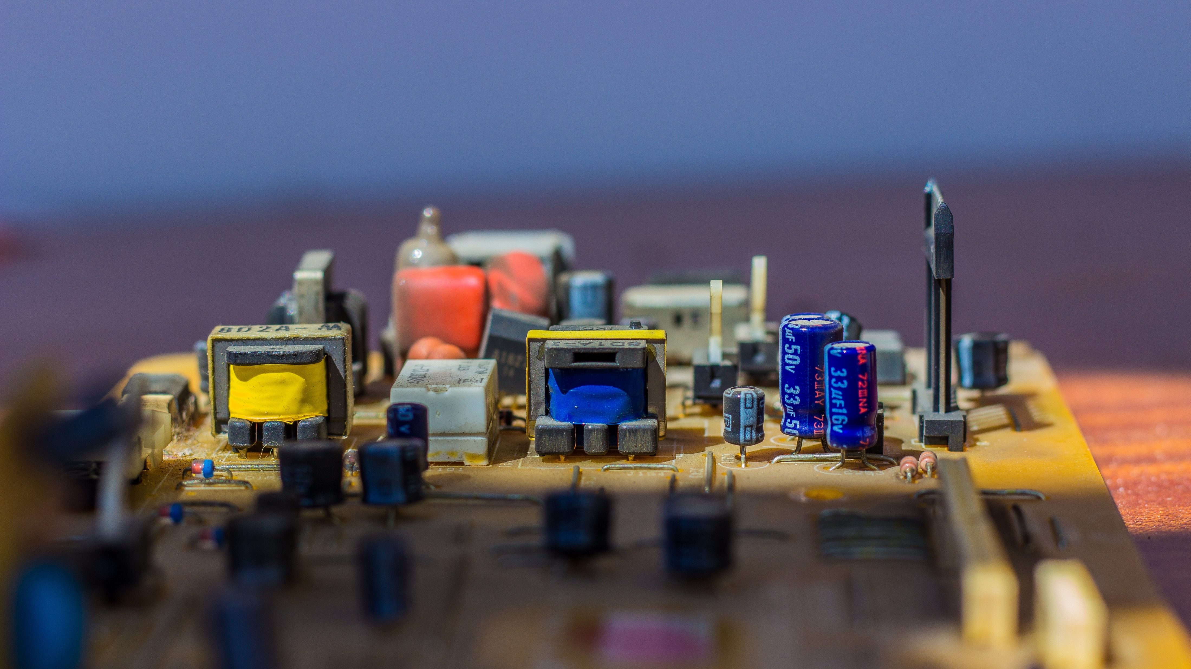
Use Big Images To Show Your Ideas

Slide 28
Shapes to explain ideas
Your Title
Your Title
Your Title
Write your description here
Write your description here
Write your description here
Your Title
Your Title
Write your description here
Write your description here

Slide 29
Features with icons
Service 01
Service 02
Service 03

Slide 30
Tables to compare data
 | A | B | C
Content A | 100 | 200 | 400
Content B | $67,000 | $56,000 | $78,000
Content C | 4500 | 60000 | $8,000

Slide 31
World Map
USA
19,450000
Europe
19,450000
Brasil
19,450000

Slide 32
56,790,500
Write here your big numbers

Slide 33
Funny Facts
56,790,500
130%
56,790,500
Revenue from sales
Project Achievements
Users around the world

Slide 34
The Process
Due to the fact that mobile lorem
Due to the fact that mobile lorem
OPTION
OPTION
OPTION
OPTION
OPTION
1
2
3
4
5
Due to the fact that mobile lorem
Due to the fact that mobile lorem
Due to the fact that mobile lorem

Slide 35
Features with icons
Content A
Content B
Content C
Itself is what the end-user derives value from also can refer to the information
Itself is what the end-user derives value from also can refer to the information
Itself is what the end-user derives value from also can refer to the information
Content D
Content E
Content F
Itself is what the end-user derives value from also can refer to the information
Itself is what the end-user derives value from also can refer to the information
Itself is what the end-user derives value from also can refer to the information

Slide 36
Use charts to present data
Your Title here
50%
Your Title here
50%
Your Title here
50%
Defined as a greater likelihood that users will share content posted to their social network many social media sites provide specific functionality

Slide 37

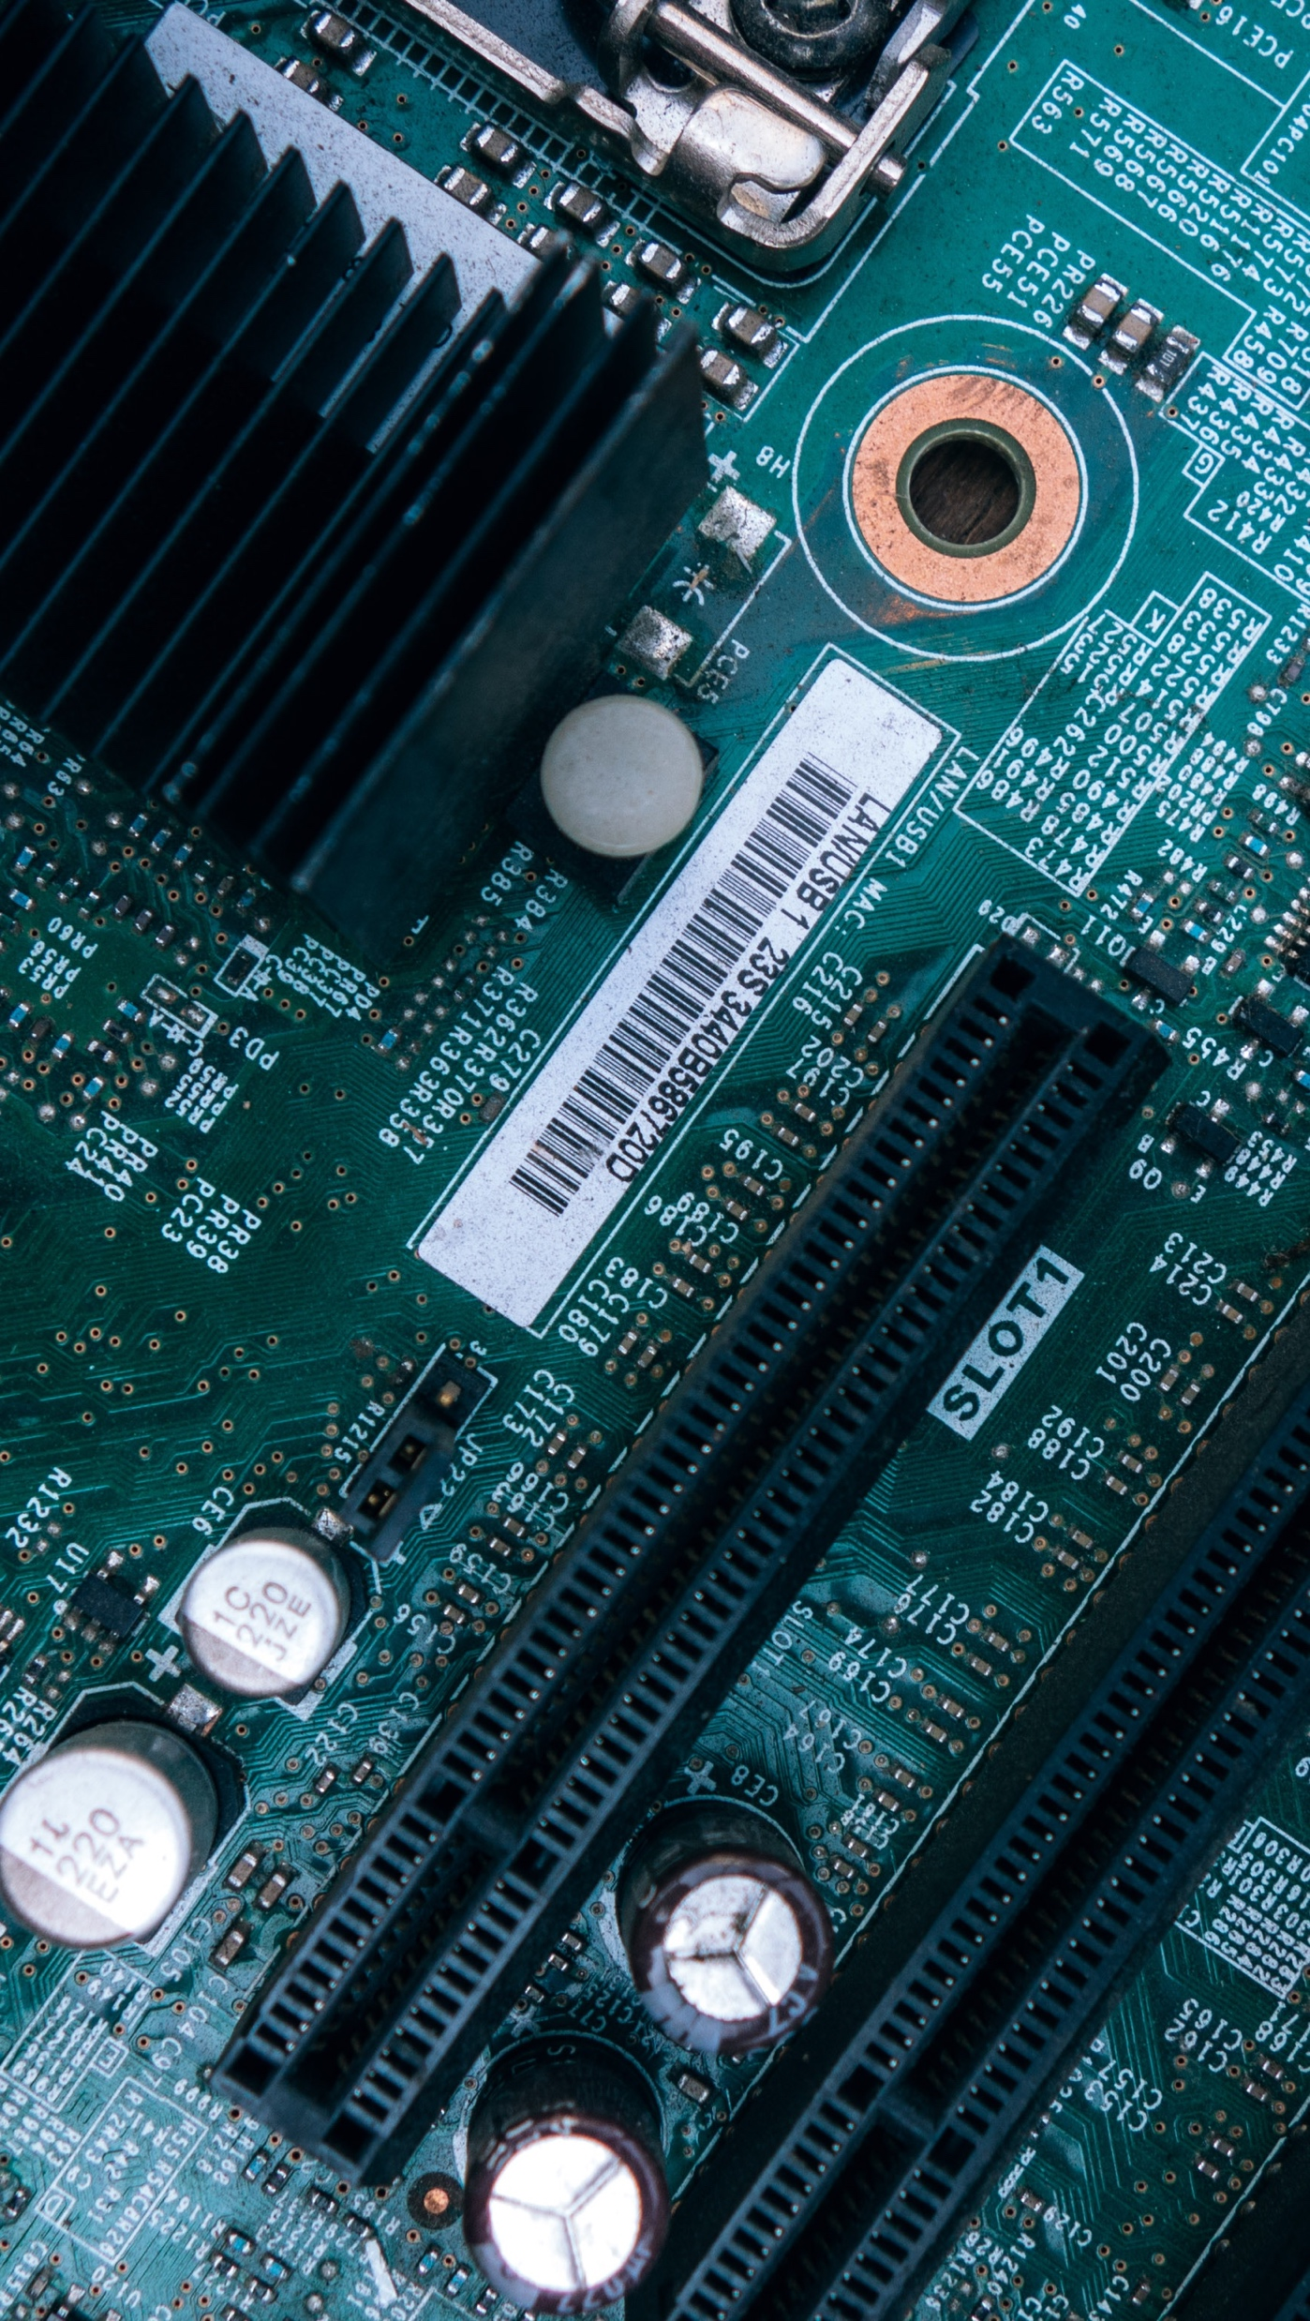
Mobile App
Itself is what the end-user derives value from also can refer is what.

Slide 38
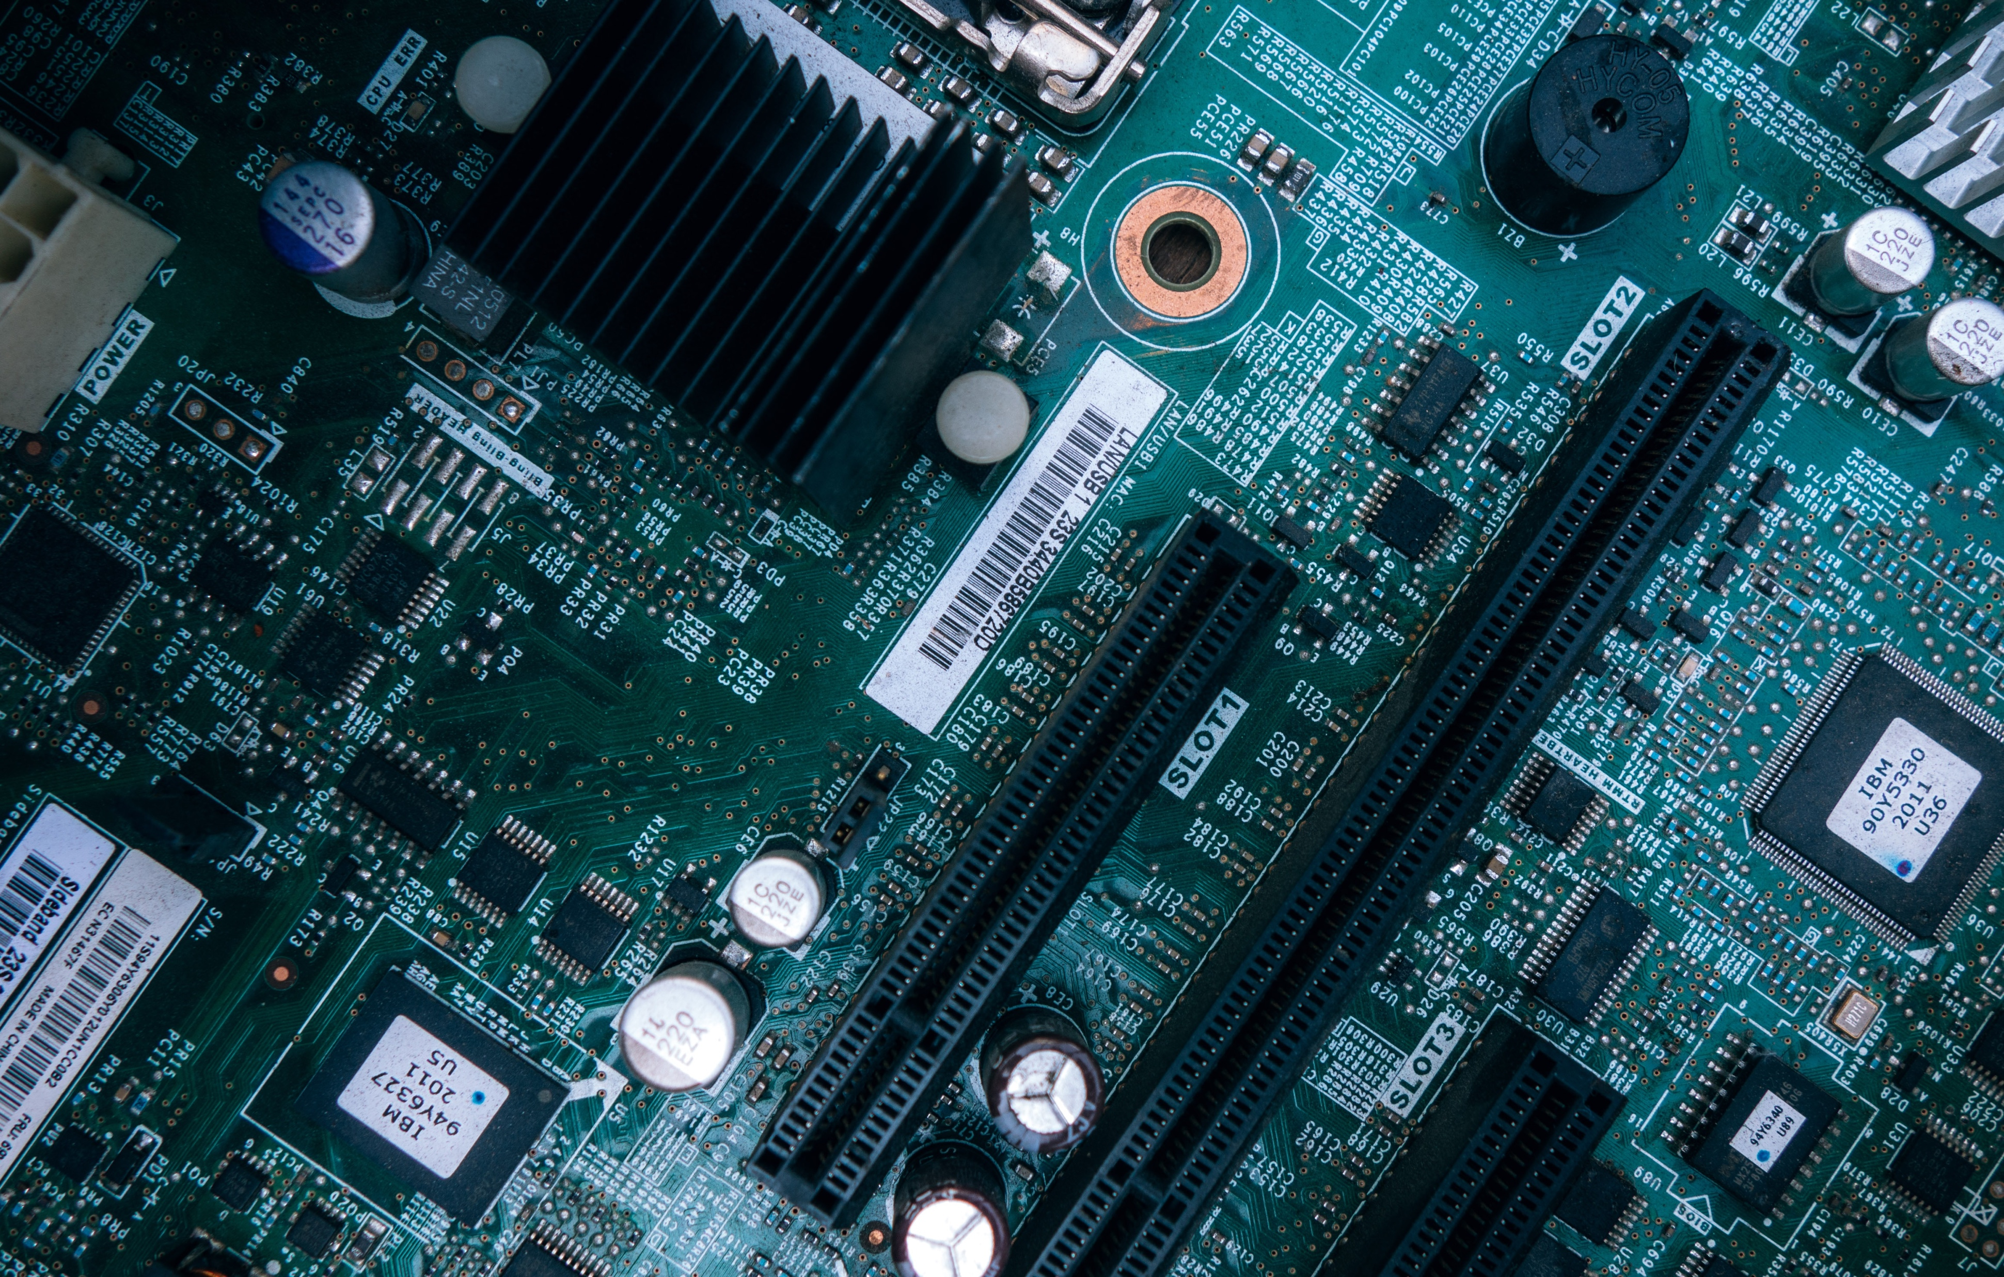
Laptop Project
Itself is what the end-user derives value from also can refer is what.

Slide 39
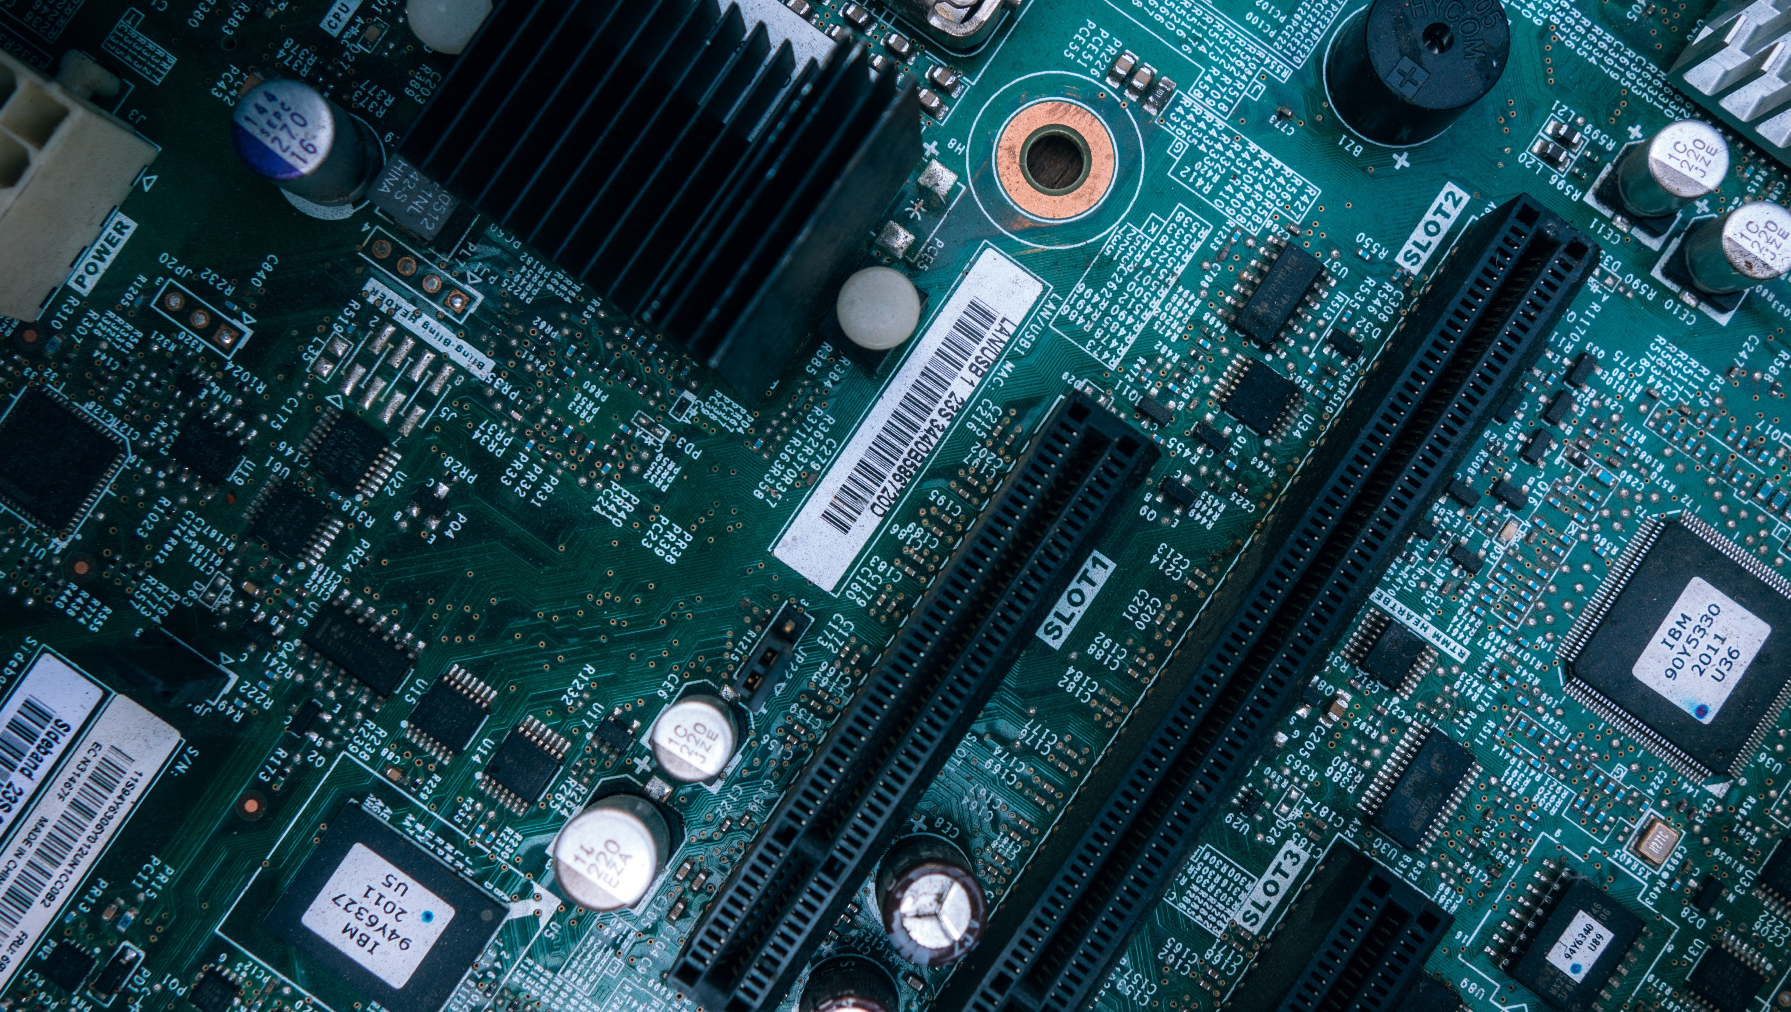
Desktop Project
Itself is what the end-user derives value from also can refer is what.

Slide 40
Thanks!
Any questions?
You can find me at: @username
myemail@domain.com

Slide 41
Credits
Special thanks to all people who made and shared these awesome resources for free:
Presentation template designed by powerpointify.com
Photographs by unsplash.com

Slide 42
Presentation design
This presentation uses the following typographies and colors:
Free Fonts used:
https://www.fontsquirrel.com/fonts/asap
Colors used:

